Slide 1


Microprocessor & Microcontroller
Module 5

Slide 2

Overview of ARM Architecture
Topic 1

Slide 3
ARM History
1983 developed by Acorn computers
To replace 6502 in BBC computers
4-man VLSI design team
Its simplicity comes from the inexperience team
Match the needs for generalized State of Charge for reasonable power performance and die size
The first commercial RISC (Reduced Instruction Set Computer) implementation
1990 ARM (Advanced RISC Machine), owned by Acorn, Apple and VLSI

Slide 4



ARM Ltd

Slide 5
Why ARM?
One of the most licensed and thus widespread processor cores in the world
Used in cell phones, multimedia players, handheld game console digital TV and cameras , digital TV and cameras
ARM7: GBA, iPod
ARM9: NDS PSP Sony Ericsson BenQ , PSP, Sony Ericsson, BenQ
ARM11: Apple iPhone, Nokia N93, N800
90% of 32-bit embedded RISC processors till 2009
Used especially in portable devices due to its low power consumption and reasonable performance

Slide 6

ARM powered products

Slide 7
ARM processors
A simple but powerful design
A whole family of designs sharing similar design principles and a common instruction set

Slide 8
Naming ARM
ARMxyzTDMIEJFS
x: series
y: MMU
z: cache
T: Thumb
D: debugger
M: Multiplier
I: Embedded ICE (built-in debugger hardware)
E: Enhanced instruction
J: Jazelle (JVM)
F: Floating-point
Synthesizable version (source code version for EDA tools)

Slide 9
Popular ARM architectures
ARM7TDMI
3 pipeline stages (fetch/decode/execute)
High code density/low power consumption
One of the most used ARM-version (for low-end systems)
All ARM cores after ARM7TDMI include TDMI even if they do not include TDMI in their labels
ARM9TDMI
Compatible with ARM7
5 stages (fetch/decode/execute/memory/write)
Separate instruction and data cache
ARM11

Slide 10
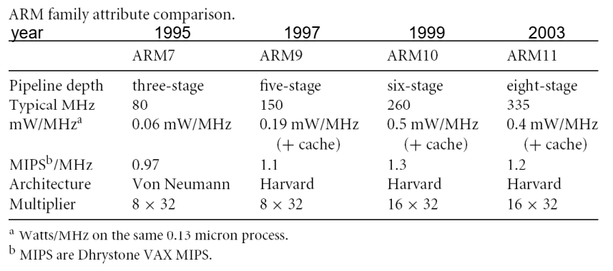
ARM family comparison

Slide 11
ARM is a RISC
RISC: simple but powerful instructions that execute within a single cycle at high clock speed.
Four major design rules:
Instructions: reduced set/single cycle/fixed length
Pipeline: decode in one stage/no need for microcode
Registers: a large set of general-purpose registers
Load/store architecture: data processing instructions apply to registers only; load/store to transfer data from memory
Results in simple design and fast clock rate
The distinction blurs because CISC (Complex Instruction Set Computer) implements RISC concepts

Slide 12
ARM design philosophy
Small processor for lower power consumption (for embedded system)
High code density for limited memory and physical size restrictions
The ability to use slow and low-cost memory
Reduced die size for reducing manufacture cost and accommodating more peripherals

Slide 13
ARM features
Different from pure RISC in several ways:
Variable cycle execution for certain instructions: multiple-register load/store (faster/higher code density)
Inline barrel shifter leading to more complex instructions: improves performance and code density
Thumb 16-bit instruction set: 30% code density improvement
Conditional execution: improve performance and code density by reducing branch
Enhanced instructions: DSP instructions

Slide 14
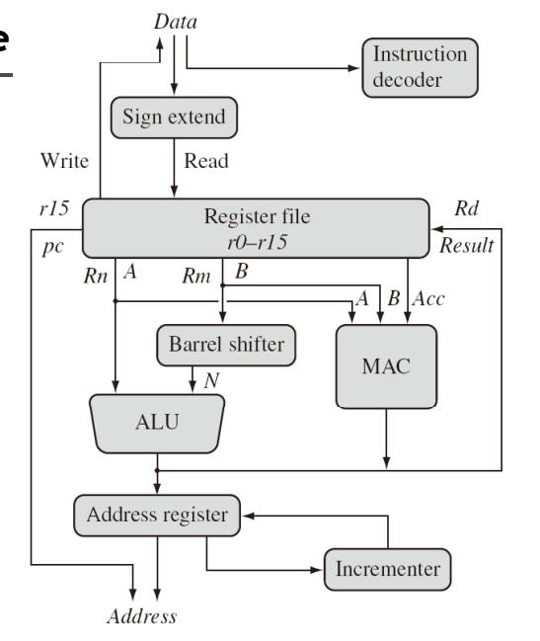
ARM architecture
Multiply Accumulate (MAC)

Slide 15
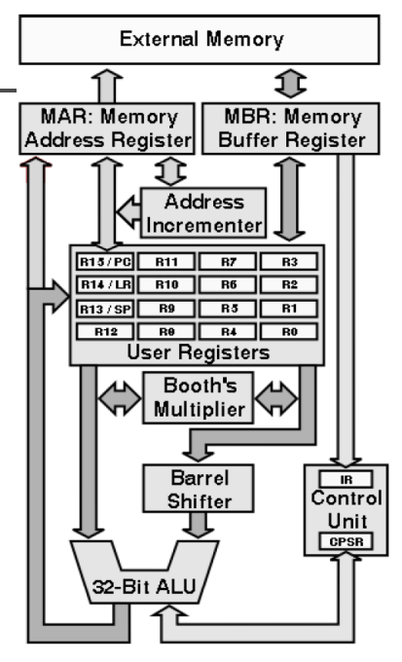

ARM architecture
Load/store architecture
A large array of uniform registers
Fixed-length 32-bit instructions
3-address instructions

Slide 16
Architecture Revisions
ARMv7
version
ARM1156T2F-S™
ARM1136JF-S™
ARMv6
XScaleTM
ARM1176JZF-S™
ARM102xE
ARM1026EJ-S™
ARMv5
StrongARM®
ARM9x6E
ARM926EJ-S™
SC200™
ARM7TDMI-S™
ARM92xT
V4
SC100™
ARM720T™
1994
1996
1998
2000
2002
2004
2006
time
XScale is a trademark of Intel Corporation

Slide 17
Versions mostly refer to the instruction set that the ARM core executes.
The ARM7, which is still the most often used core in a low-power design, executes the version 4T instruction set.
Architectural extensions were added for version 5TE to include DSP instructions, such as 16-bit signed MLA instructions, saturation arithmetic, etc.
The ARM926EJ-S and ARM1026EJ-S cores are examples of Version 5 architectures.
Version 6 added instructions for doing byte manipulations and graphics algorithms more efficiently.
The ARM11 family implemented the Version 6 architecture.
Version 7 architectures (which include the Cortex family of cores, such as the Cortex A8, Cortex M3 and Cortex R4) extended the functionality by adding things such as Thumb2, low-power features, and more security.

Slide 18
Registers
Only 16 registers are visible to a specific mode.
A mode could access
A particular set of r0-r12
r13 (sp, stack pointer)
r14 (lr, link register)
r15 (pc, program counter)
Current program status register (cpsr)
The uses of r0-r13 are orthogonal

Slide 19
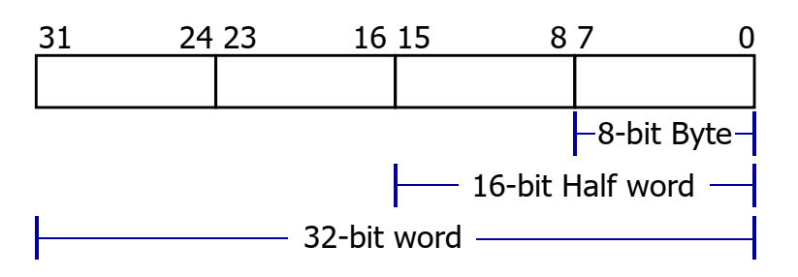
General-purpose registers
6 data types (signed/unsigned)
All ARM operations are 32-bit.
Shorter data types are only supported by data transfer operations.

Slide 20
Program counter
Store the address of the instruction to be executed
All instructions are 32-bit wide and word-aligned
Thus, the last two bits of pc are undefined.

Slide 21
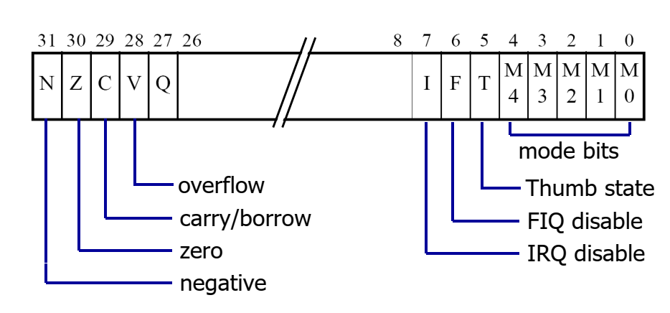
Program status register (CPSR)

Slide 22
Different modes of ARM processor
Topic 2

Slide 23
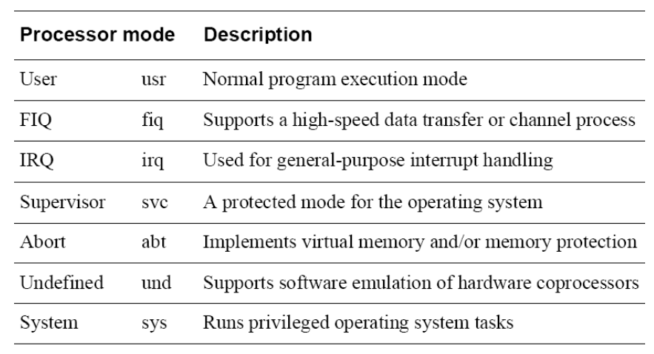
Processor modes

Slide 24
Processor modes
Mode |  | Description | Family
User | usr | Normal program execution, no privileges | All
FIQ | fiq | Fast interrupt handling | All
IRQ | irq | Normal interrupt handling | All
Supervisor | svc | Privileged mode for the operating system | All
Abort | abt | For virtual memory and memory protection | ARMv3+
Undefined | und | Facilitates emulation of co-processors in hardware | ARMv3+
System | sys | Runs programs with some privileges | ARMv4+

Slide 25
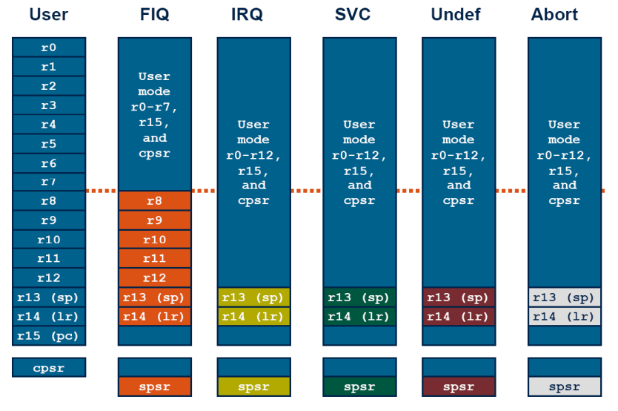
Register organization

Slide 26
Processor modes
User mode
This is the mode in which user application tasks should run. It has access to the base register set, and no privileges.
FIQ mode
The ARM processor supports two types of interrupt handling. There is the regular type of interrupt, and there is this, the fast interrupt. The difference is that fast interrupts can interrupt regular ones.
IRQ mode
This is the other, regular, interrupt mode. Only R13, R14, and CPSR are shadowed.

Slide 27
SVC mode
This is the privileged mode reserved for the operating system. R13, R14, and CPSR are shadowed.
Abort mode
An abort is signalled by the memory system as a result of a failure to load either an instruction (Prefetch Abort) or data (Data abort).
Undefined mode
When an undefined instruction is encountered, the ARM will wait for a coprocessor to acknowledge that it can deal with the instruction (if in co-processor instruction space). If no coprocessor responds, or the instruction is one that is not defined, then the undefined instruction vector is taken.
System mode
It is like a cross between SVC and USR. System mode offers the privileges of SVC mode, however it uses the USR registers.

Slide 28
Instruction Set of ARM Processor
Topic 3

Slide 29
The ARM Instruction Set
ARM
Advanced RISC Machines

Slide 30
Main features of the ARM Instruction Set
All instructions are 32 bits long.
Most instructions execute in a single cycle.
Every instruction can be conditionally executed.
A load/store architecture
Data processing instructions act only on registers
Three operand format
Combined ALU and shifter for high speed bit manipulation
Specific memory access instructions with powerful auto-indexing addressing modes.
32 bit and 8 bit data types
and also 16 bit data types on ARM Architecture v4.
Flexible multiple register load and store instructions
Instruction set extension via coprocessors

Slide 31
Processor Modes
The ARM has six operating modes:
User (unprivileged mode under which most tasks run)
FIQ (entered when a high priority (fast) interrupt is raised)
IRQ (entered when a low priority (normal) interrupt is raised)
Supervisor (entered on reset and when a Software Interrupt instruction is executed)
Abort (used to handle memory access violations)
Undef (used to handle undefined instructions)
ARM Architecture Version 4 adds a seventh mode:
System (privileged mode using the same registers as user mode)

Slide 32
The Registers
ARM has 37 registers in total, all of which are 32-bits long.
1 dedicated program counter
1 dedicated current program status register
5 dedicated saved program status registers
30 general purpose registers
However these are arranged into several banks, with the accessible bank being governed by the processor mode. Each mode can access
a particular set of r0-r12 registers
a particular r13 (the stack pointer) and r14 (link register)
r15 (the program counter)
cpsr (the current program status register)
and privileged modes can also access
a particular spsr (saved program status register)

Slide 33
Register Organisation
General registers and Program Counter
User32 / System
FIQ32
Supervisor32
Abort32
IRQ32
Undefined32
r0
r0
r0
r0
r0
r0
r1
r1
r1
r1
r1
r1
r2
r2
r2
r2
r2
r2
r3
r3
r3
r3
r3
r3
r4
r4
r4
r4
r4
r4
r5
r5
r5
r5
r5
r5
r6
r6
r6
r6
r6
r6
r7
r7
r7
r7
r7
r7
r8
r8_fiq
r8
r8
r8
r8
r9
r9_fiq
r9
r9
r9
r9
r10
r10_fiq
r10
r10
r10
r10
r11
r11_fiq
r11
r11
r11
r11
r12
r12_fiq
r12
r12
r12
r12
r13 (sp)
r13_fiq
r13_svc
r13_abt
r13_irq
r13_undef
r14 (lr)
r14_fiq
r14_svc
r14_abt
r14_irq
r14_undef
r15 (pc)
r15 (pc)
r15 (pc)
r15 (pc)
r15 (pc)
r15 (pc)
Program Status Registers
cpsr
cpsr
cpsr
cpsr
cpsr
cpsr
sprsr_fiq
sprsr_fiq
sprsr_fiq
sprsr_fiq
sprsr_fiq
spsr_fiq
spsr_svc
spsr_abt
sprsr_fiq
sprsr_fiq
sprsr_fiq
sprsr_fiq
sprsr_fiq
spsr_irq
spsr_undef
sprsr_fiq
sprsr_fiq
sprsr_fiq
sprsr_fiq
sprsr_fiq

Slide 34
Register Example: User to FIQ Mode
Registers in use
Registers in use
User Mode
FIQ Mode
r0
r0
r1
r1
r2
r2
r3
r3
r4
r4
r5
r5
r6
r6
r7
EXCEPTION
r7
r8
r8_fiq
r8
r8_fiq
r9
r9_fiq
r9
r9_fiq
r10
r10_fiq
r10
r10_fiq
r11
r11_fiq
r11
r11_fiq
r12
r12_fiq
r12
r12_fiq
r13 (sp)
r13_fiq
r13 (sp)
r13_fiq
r14 (lr)
r14_fiq
r14 (lr)
r14_fiq
r15 (pc)
Return address calculated from User mode PC value and stored in FIQ mode LR
r15 (pc)
cpsr
cpsr
spsr_fiq
spsr_fiq
User mode CPSR copied to FIQ mode SPSR
Notes:
Similarly in other 4 modes, though here only r13->r14 swapped.
“Banked” registers stored between mode swaps. Useful for interrupt handling because nothing to set up. Can thus run more quickly.

Slide 35
Accessing Registers using ARM Instructions
No breakdown of currently accessible registers.
All instructions can access r0-r14 directly.
Most instructions also allow use of the PC.
Specific instructions to allow access to CPSR and SPSR.
Note : When in a privileged mode, it is also possible to load / store the (banked out) user mode registers to or from memory.
See later for details.

Slide 36
The Program Status Registers (CPSR and SPSRs)
31
28
8
4
0
N
Z
C
V
I F T
Mode
Copies of the ALU status flags (latched if the
instruction has the "S" bit set).
* Condition Code Flags
* Interrupt Disable bits.
I = 1, disables the IRQ.
F = 1, disables the FIQ.
* T Bit (Architecture v4T only)
T = 0, Processor in ARM state
T = 1, Processor in Thumb state
N = Negative result from ALU flag.
Z = Zero result from ALU flag.
C = ALU operation Carried out
V = ALU operation oVerflowed
* Mode Bits
M[4:0] define the processor mode.
Notes:
Current Program Status Register (CPSR) can be considered as an extension of the PC. It contains the:
condition code flags, N,Z,C,V.
interrupt (FIQ, IRQ) disable bits
mode bits
T bit
Software must never change value in TBIT. If this happens, the processor will enter an unpredictable state.
Lower 28 bits known as the "control bits".
Bits other than the specified interrupt and mode bits are reserved for future processors, and no program should depend on their values.
The condition codes in the CPSR will be preserved or updated depending on the value of the S bit in the instruction.
Some instructions do alter condition flags regardless of “S”, ie CMN, CMP, TST and TEQ (return no other result).
Mode field bigger than needs to be - just history.
Only six modes valid on pre-ARM Architecture v4 chips.
SPSRs
Also five other PSRs, the Saved Program Status Registers, one for each privilege mode, into which a copy of the CPSR is loaded when an exception occurs.

Slide 37
The Program Counter (R15)
When the processor is executing in ARM state:
All instructions are 32 bits in length
All instructions must be word aligned
Therefore the PC value is stored in bits [31:2] with bits [1:0] equal to zero (as instruction cannot be halfword or byte aligned).
R14 is used as the subroutine link register (LR) and stores the return address when Branch with Link operations are performed, calculated from the PC.
Thus to return from a linked branch
MOV r15,r14
or
MOV pc,lr
Notes:
PC held in register R15
Instructions always a word long, so must be aligned with word boundaries. But addresses specified in bytes, so 2 lsbs will be zero.
ie bits [31:2] store word address, bits [1:0] always zero.
R15 may :
be specified as the base register (Rn) in Load and Store instructions, allowing PC-relative addressing to be used.
be the destination register, Rd, for instructions. When the “S” bit is not set the operation overwrites R15 without affecting the CPSR. When the “S” bit is set, in a privileged mode, then SPSR_<mode> is transferred to CPSR at the same time R15 is loaded.

Slide 38
Exception Handling and the Vector Table
When an exception occurs, the core:
Copies CPSR into SPSR_<mode>
Sets appropriate CPSR bits
If core implements ARM Architecture 4T and is currently in Thumb state, then
ARM state is entered.
Mode field bits
Interrupt disable flags if appropriate.
Maps in appropriate banked registers
Stores the “return address” in LR_<mode>
Sets PC to vector address
To return, exception handler needs to:
Restore CPSR from SPSR_<mode>
Restore PC from LR_<mode>
Notes:
Exceptions, in order serviced, are:
Reset - supervisor mode
Data abort - abort mode
External Fast Interrupt Request - FIQ mode (eg DMA)
External Interrupt Request - IRQ mode
Instruction Prefetch abort - abort mode
Software Interrupt (SWI)- supervisor mode (typically used to extend operating system)
Undefined instruction - undefined mode
Only one memory location for each vector
Each vector contains branch to that particular exception handler
FIQ vector is last one. This allows its handler to be run sequentially from that address, removing need for branch and its associated delays. Important because speed is essential for FIQ.
Interrupt routine’s responsibility to clear interrupt condition.
Can return using one instruction
See exception handling module for details.

Slide 39
The Instruction Pipeline
The ARM uses a pipeline in order to increase the speed of the flow of instructions to the processor.
Allows several operations to be undertaken simultaneously, rather than serially.
Rather than pointing to the instruction being executed, the PC points to the instruction being fetched.
ARM
PC
FETCH
Instruction fetched from memory
PC - 4
DECODE
Decoding of registers used in instruction
PC - 8
EXECUTE
Register(s) read from Register Bank
Shift and ALU operation
Write register(s) back to Register Bank
Notes:
Each instruction is one word (or 32 bits)
Thus each stage in pipeline is one word
In other words 4 bytes, hence the offsets of 4 and 8 used here.
Most instructions execute in a single cycle
Helps to keep the pipeline operating efficiently - only stalls if executing instruction takes several cycles.
Thus every cycle, processor can be loading one instruction, decoding another, whilst executing a third.
Typically the PC can be assumed to be current instruction plus 8
Cases when not case include
When exceptions taken the address stored in LR varies - see Exception Handling module for more details.
When PC used in some data processing operations value is unpredictable - see datasheet

Slide 40
ARM Instruction Set Format
31
28
27
16
15
8
7
0
Instruction type
Data processing / PSR Transfer
Multiply
Long Multiply (v3M / v4 only)
Swap
Load/Store Byte/Word
Load/Store Multiple
Halfword transfer : Immediate offset (v4 only)
Halfword transfer: Register offset (v4 only)
Branch
Branch Exchange (v4T only)
Coprocessor data transfer
Coprocessor data operation
Coprocessor register transfer
Software interrupt
Cond 0 0 I Opcode S Rn Rd Operand2
Cond 0 0 0 0 0 0 A S Rd Rn Rs 1 0 0 1 Rm
Cond 0 0 0 0 1 U A S RdHi RdLo Rs 1 0 0 1 Rm
Cond 0 0 0 1 0 B 0 0 Rn Rd 0 0 0 0 1 0 0 1 Rm
Cond 0 1 I P U B W L Rn Rd Offset
Cond 1 0 0 P U S W L Rn Register List
Cond 0 0 0 P U 1 W L Rn Rd Offset1 1 S H 1 Offset2
Cond 0 0 0 P U 0 W L Rn Rd 0 0 0 0 1 S H 1 Rm
Cond 1 0 1 L Offset
Cond 0 0 0 1 0 0 1 0 1 1 1 1 1 1 1 1 1 1 1 1 0 0 0 1 Rn
Cond 1 1 0 P U N W L Rn CRd CPNum Offset
Cond 1 1 1 0 Op1 CRn CRd CPNum Op2 0 CRm
Cond 1 1 1 0 Op1 L CRn Rd CPNum Op2 1 CRm
Cond 1 1 1 1 SWI Number

Slide 41
Conditional Execution
Most instruction sets only allow branches to be executed conditionally.
However by reusing the condition evaluation hardware, ARM effectively increases number of instructions.
All instructions contain a condition field which determines whether the CPU will execute them.
Non-executed instructions soak up 1 cycle.
Still have to complete cycle so as to allow fetching and decoding of following instructions.
This removes the need for many branches, which stall the pipeline (3 cycles to refill).
Allows very dense in-line code, without branches.
The Time penalty of not executing several conditional instructions is frequently less than overhead of the branch or subroutine call that would otherwise be needed.

Slide 42
The Condition Field
31
28
24
20
16
12
8
4
0
Cond
0000 = EQ - Z set (equal)
0001 = NE - Z clear (not equal)
0010 = HS / CS - C set (unsigned higher or same)
0011 = LO / CC - C clear (unsigned lower)
0100 = MI -N set (negative)
0101 = PL - N clear (positive or zero)
0110 = VS - V set (overflow)
0111 = VC - V clear (no overflow)
1000 = HI - C set and Z clear (unsigned higher)
1001 = LS - C clear or Z (set unsigned lower or same)
1010 = GE - N set and V set, or N clear and V clear (>or =)
1011 = LT - N set and V clear, or N clear and V set (>)
1100 = GT - Z clear, and either N set and V set, or N clear and V set (>)
1101 = LE - Z set, or N set and V clear,or N clear and V set (<, or =)
1110 = AL - always
1111 = NV - reserved.
Notes:
4 bit Condition Field refers to the values of the appropriate bits in the CPSR, as indicated on slide.
Most instructions assembled with default condition code "always" (1110, AL).
This means the instruction will be executed irrespective of the flags in CPSR.
The "never" code (1111, NV) is reserved.
This family of conditions will be redefined for future use in other ARM devices.
Use MOV r0, r0 as NOP operation.
Conditional instructions aids code density
remove need for many branches (discussed earlier)

Slide 43
Using and updating the Condition Field
To execute an instruction conditionally, simply postfix it with the appropriate condition:
For example an add instruction takes the form:
ADD r0,r1,r2 ; r0 = r1 + r2 (ADDAL)
To execute this only if the zero flag is set:
ADDEQ r0,r1,r2 ; If zero flag set then… ; ... r0 = r1 + r2
By default, data processing operations do not affect the condition flags (apart from the comparisons where this is the only effect). To cause the condition flags to be updated, the S bit of the instruction needs to be set by postfixing the instruction (and any condition code) with an “S”.
For example to add two numbers and set the condition flags:
ADDS r0,r1,r2 ; r0 = r1 + r2 ; ... and set flags

Slide 44
Branch instructions (1)
Branch : B{<cond>} label
Branch with Link : BL{<cond>} sub_routine_label
The offset for branch instructions is calculated by the assembler:
By taking the difference between the branch instruction and the target address minus 8 (to allow for the pipeline).
This gives a 26 bit offset which is right shifted 2 bits (as the bottom two bits are always zero as instructions are word – aligned) and stored into the instruction encoding.
This gives a range of ± 32 Mbytes.
31
28
27
25
24
23
0
Cond 1 0 1 L Offset
Link bit 0 = Branch
1 = Branch with link
Condition field
Notes:
Branch instructions are PC-relative rather than absolute:
Branch instructions’ encoding contain a signed 2's complement 24 bit offset which is calculated by the assembler from the destination label given in the source code.

Slide 45
Branch instructions (2)
When executing the instruction, the processor:
shifts the offset left two bits, sign extends it to 32 bits, and adds it to PC.
Execution then continues from the new PC, once the pipeline has been refilled.
The "Branch with link" instruction implements a subroutine call by writing PC-4 into the LR of the current bank.
i.e. the address of the next instruction following the branch with link (allowing for the pipeline).
To return from subroutine, simply need to restore the PC from the LR:
MOV pc, lr
Again, pipeline has to refill before execution continues.
The "Branch" instruction does not affect LR.
Note: Architecture 4T offers a further ARM branch instruction, BX
See Thumb Instruction Set Module for details.
Notes:
Branch offset must take account of the PC's prefetch offset, which is handled by the assembler
In effect subtracts 8 before using it : PC normally +8 of what actually executing - pipeline.
The Branch with Link (BL) writes the old PC into the link register (R14) of the current bank.
Again PC value saved adjusted for the prefetch offset to point to the next instruction after the BL instruction.
ie saves PC - 4
CPSR has NOT been saved with the PC.
Return using
MOV pc, lr
Branch Instruction takes 3 cycles because of refilling the pipeline. Similarly on return.

Slide 46
Data processing Instructions
Largest family of ARM instructions, all sharing the same instruction format.
Contains:
Arithmetic operations
Comparisons (no results - just set condition codes)
Logical operations
Data movement between registers
Remember, this is a load / store architecture
These instruction only work on registers, NOT memory.
They each perform a specific operation on one or two operands.
First operand always a register - Rn
Second operand sent to the ALU via barrel shifter.
We will examine the barrel shifter shortly.

Slide 47
Arithmetic Operations
Operations are:
ADD operand1 + operand2
ADC operand1 + operand2 + carry
SUB operand1 - operand2
SBC operand1 - operand2 + carry -1
RSB operand2 - operand1
RSC operand2 - operand1 + carry - 1
Syntax:
<Operation>{<cond>}{S} Rd, Rn, Operand2
Examples
ADD r0, r1, r2
SUBGT r3, r3, #1
RSBLES r4, r5, #5

Slide 48
Comparisons
The only effect of the comparisons is to
UPDATE THE CONDITION FLAGS. Thus no need to set S bit.
Operations are:
CMP operand1 - operand2, but result not written
CMN operand1 + operand2, but result not written
TST operand1 AND operand2, but result not written
TEQ operand1 EOR operand2, but result not written
Syntax:
<Operation>{<cond>} Rn, Operand2
Examples:
CMP r0, r1
TSTEQ r2, #5

Slide 49
Logical Operations
Operations are:
AND operand1 AND operand2
EOR operand1 EOR operand2
ORR operand1 OR operand2
BIC operand1 AND NOT operand2 [ie bit clear]
Syntax:
<Operation>{<cond>}{S} Rd, Rn, Operand2
Examples:
AND r0, r1, r2
BICEQ r2, r3, #7
EORS r1,r3,r0

Slide 50
Data Movement
Operations are:
MOV operand2
MVN NOT operand2
Note that these make no use of operand1.
Syntax:
<Operation>{<cond>}{S} Rd, Operand2
Examples:
MOV r0, r1
MOVS r2, #10
MVNEQ r1,#0

Slide 51
The Barrel Shifter
The ARM doesn’t have actual shift instructions.
Instead it has a barrel shifter which provides a mechanism to carry out shifts as part of other instructions.
So what operations does the barrel shifter support?

Slide 52
Barrel Shifter - Left Shift
Shifts left by the specified amount (multiplies by powers of two) e.g.
LSL #5 = multiply by 32
Logical Shift Left (LSL)
CF
Destination
0
Notes:
Effectively x 2^{n.}
bits of operand shifted left by specified number of bits.
Zeros are inserted into the right most end of the word
last bit removed from the left most end placed in carry flag.
LSL #0 does nothing and is the default shift if none is specified.

Slide 53
Barrel Shifter - Right Shifts
Logical Shift Right
Shifts right by the specified amount (divides by powers of two) e.g.
LSR #5 = divide by 32
Arithmetic Shift Right
Shifts right (divides by powers of two) and preserves the sign bit, for 2's complement operations. e.g.
ASR #5 = divide by 32
Logical Shift Right
Destination
CF
...0
Arithmetic Shift Right
Destination
CF
Sign bit shifted in
Notes:
LSR moves each bit of the register (Rm) to the right by the specified amount.
eg / LSR #5
all bits are moved 5 places to right (i.e. into less significant positions).
most significant positions then filled with zeros
least significant five bits of Rm are removed. The last of these five bits becomes the shifter Carry output, and may set the CPSR's C flag (when the ALU operation is in the logical class).
An LSR 0 is translated into an LSR 32, to put bit 31 of the word into the carry flag.
ASR similar to LSR except that
high bits are filled with bit 31 of Rm (the sign bit) instead of zeros.
This preserves the sign in 2's complement notation.
eg/
Divide a 2's complement number 10000010B (or -126) in Ra by 2.
MOV Ra, Ra, ASR #2
From Ra=10000010B we get RA=11000001B (or - 63)
An ASR #0 is translated into an ASR #32, to propagate bit 31 of the word into every bit in the word as well as the carry flag.

Slide 54
Barrel Shifter - Rotations
Rotate Right (ROR)
• Similar to an ASR but the bits wrap around as they leave the LSB and appear as the MSB.
e.g. ROR #5
Note the last bit rotated is also used as the Carry Out.
Rotate Right Extended (RRX)
• This operation uses the CPSR C flag as a 33rd bit.
Rotates right by 1 bit. Encoded as ROR #0.
Rotate Right
Destination
CF
Rotate Right through Carry
Destination
CF
Notes:
Rotate Right (ROR), and Rotate Right Extended (RRX) operations
used to manipulate the bits in a register without destroying those bits.
move each bit of the register (Rm) by the specified amount.
eg/ ROR #5
all bits moved 5 places to the right (i.e. into less significant positions).
However, rather than being discarded the bits shifted out are then rotated back to other high of the register
in ROR the bit previously at [0] is rotated to the MSB, [31]
In RRX - Carry flag included as a 33rd bit in the operation. Bit 0 becomes the Carry out, while the C becomes the MSB
RRX actually encoded as ROR #0
Example of use: in random number generator given in datasheet
.

Slide 55
Using the Barrel Shifter: The Second Operand
Operand 1
Operand 2
Register, optionally with shift operation applied.
Shift value can be either be:
5 bit unsigned integer
Specified in bottom byte of another register.
Barrel Shifter
Immediate value
8 bit number
Can be rotated right through an even number of positions.
Assembler will calculate rotate for you from constant.
ALU
Result

Slide 56
Second Operand : Shifted Register
The amount by which the register is to be shifted is contained in either:
the immediate 5-bit field in the instruction
NO OVERHEAD
Shift is done for free - executes in single cycle.
the bottom byte of a register (not PC)
Then takes extra cycle to execute
ARM doesn’t have enough read ports to read 3 registers at once.
Then same as on other processors where shift is separate instruction.
If no shift is specified then a default shift is applied: LSL #0
i.e. barrel shifter has no effect on value in register.

Slide 57
Second Operand : Using a Shifted Register
Using a multiplication instruction to multiply by a constant means first loading the constant into a register and then waiting a number of internal cycles for the instruction to complete.
A more optimum solution can often be found by using some combination of MOVs, ADDs, SUBs and RSBs with shifts.
Multiplications by a constant equal to a ((power of 2) ± 1) can be done in one cycle.
Example: r0 = r1 * 5 Example: r0 = r1 + (r1 * 4)
ï ADD r0, r1, r1, LSL #2
Example: r2 = r3 * 105 Example: r2 = r3 * 15 * 7 Example: r2 = r3 * (16 - 1) * (8 - 1) ï RSB r2, r3, r3, LSL #4 ; r2 = r3 * 15 ï RSB r2, r2, r2, LSL #3 ; r2 = r2 * 7
Notes:
Main use for a shifted register is to provide inline multiplication (and division)
Using one or more instructions with shifted registers.
This can often be quicker than using MUL instruction, though not as flexible.
Need to know constant at compile / assemble time.
The problem of finding the optimum sequence becomes more difficult as constant becomes larger.
No known algorithm to solve this problem quickly.
C compiler restricts amount of searching it does in order to minimise impact on compile time
Has cut-off so that uses normal MUL once number of instructions used in squence passes a limit.
Sequences could otherwise become very long.

Slide 58
Second Operand : Immediate Value (1)
There is no single instruction which will load a 32 bit immediate constant into a register without performing a data load from memory.
All ARM instructions are 32 bits long
ARM instructions do not use the instruction stream as data.
The data processing instruction format has 12 bits available for operand2
If used directly this would only give a range of 4096.
Instead it is used to store 8 bit constants, giving a range of 0 - 255.
These 8 bits can then be rotated right through an even number of positions (ie RORs by 0, 2, 4,..30).
This gives a much larger range of constants that can be directly loaded, though some constants will still need to be loaded from memory.

Slide 59
Second Operand : Immediate Value (2)
This gives us:
0 - 255 [0 - 0xff]
256,260,264,..,1020 [0x100-0x3fc, step 4, 0x40-0xff ror 30]
1024,1040,1056,..,4080 [0x400-0xff0, step 16, 0x40-0xff ror 28]
4096,4160, 4224,..,16320 [0x1000-0x3fc0, step 64, 0x40-0xff ror 26]
These can be loaded using, for example:
MOV r0, #0x40, 26 ; => MOV r0, #0x1000 (ie 4096)
To make this easier, the assembler will convert to this form for us if simply given the required constant:
MOV r0, #4096 ; => MOV r0, #0x1000 (ie 0x40 ror 26)
The bitwise complements can also be formed using MVN:
MOV r0, #0xFFFFFFFF ; assembles to MVN r0, #0
If the required constant cannot be generated, an error will be reported.
Notes:
mov r0, #256 ; mov r0, #0x100
mov r1, #0x40, 30 ; mov r1, #0x100
mov r2, #1020 ; mov r2, #0x3fc
mov r3, #0xff, 30 ; mov r3, #0x3fc
mov r4, #1024 ; mov r4, #0x400
mov r5, #0x40, 28 ; mov r5, #0x400
mov r6, #4080 ; mov r6, #0xff0
mov r7, #0xff, 28 ; mov r7, #0xff0
mov r8, #4096 ; mov r8, #0x1000
mov r9, #0x40, 26 ; mov r9, #0x1000
mov r10, #16320 ; mov r10, #0x3fc0
mov r11, #0xff, 26 ; mov r11, #0x3fc0

Slide 60
Loading full 32 bit constants
Although the MOV/MVN mechansim will load a large range of constants into a register, sometimes this mechansim will not generate the required constant.
Therefore, the assembler also provides a method which will load ANY 32 bit constant:
LDR rd,=numeric constant
If the constant can be constructed using either a MOV or MVN then this will be the instruction actually generated.
Otherwise, the assembler will produce an LDR instruction with a PC-relative address to read the constant from a literal pool.
LDR r0,=0x42 ; generates MOV r0,#0x42
LDR r0,=0x55555555 ; generate LDR r0,[pc, offset to lit pool]
As this mechanism will always generate the best instruction for a given case, it is the recommended way of loading constants.
Notes:
Literal pools
These are constant data areas embedded in the code at the end of modules, and between functions if required by the user.

Slide 61
Multiplication Instructions
The Basic ARM provides two multiplication instructions.
Multiply
MUL{<cond>}{S} Rd, Rm, Rs ; Rd = Rm * Rs
Multiply Accumulate - does addition for free
MLA{<cond>}{S} Rd, Rm, Rs,Rn ; Rd = (Rm * Rs) + Rn
Restrictions on use:
Rd and Rm cannot be the same register
Can be avoid by swapping Rm and Rs around. This works because multiplication is commutative.
Cannot use PC.
These will be picked up by the assembler if overlooked.
Operands can be considered signed or unsigned
Up to user to interpret correctly.
Notes:
One example of use of MLA is for string to number conversion:
eg/
Convert string=“123” to value=123
value = 0
loop = 0
len = length of string
while loop <> len
c = extract( string, len -loop,1)
Rm = 10 ^ loop
Rs = ASC(c) - ASC (‘0’)
Rd = value
MLA Rd, Rm, Rs, Rd
loop = loop + 1
endwhile

Slide 62
Multiplication Implementation
The ARM makes use of Booth’s Algorithm to perform integer multiplication.
On non-M ARMs this operates on 2 bits of Rs at a time.
For each pair of bits this takes 1 cycle (plus 1 cycle to start with).
However when there are no more 1’s left in Rs, the multiplication will early-terminate.
Example: Multiply 18 and -1 : Rd = Rm * Rs
Note: Compiler does not use early termination criteria to decide on which order to place operands.
Rm
18
0 0 0 0
0 0 0 0
0 0 0 0
0 0 0 0
0 0 0 0
0 0 0 0
0 0 0 1
0 0 1 0
18
Rs
Rs
-1
1 1 1 1
1 1 1 1
1 1 1 1
1 1 1 1
1 1 1 1
1 1 1 1
1 1 1 1
1 1 1 1
-1
Rm
17 cycles
4 cycles

Slide 63
Extended Multiply Instructions
M variants of ARM cores contain extended multiplication hardware. This provides three enhancements:
An 8 bit Booth’s Algorithm is used
Multiplication is carried out faster (maximum for standard instructions is now 5 cycles).
Early termination method improved so that now completes multiplication when all remaining bit sets contain
all zeroes (as with non-M ARMs), or
all ones.
Thus the previous example would early terminate in 2 cycles in both cases.
64 bit results can now be produced from two 32bit operands
Higher accuracy.
Pair of registers used to store result.
Notes:
Where M variants are Arch v3M and 4.

Slide 64
Multiply-Long and Multiply-Accumulate Long
Instructions are
MULL which gives RdHi,RdLo:=Rm*Rs
MLAL which gives RdHi,RdLo:=(Rm*Rs)+RdHi,RdLo
However the full 64 bit of the result now matter (lower precision multiply instructions simply throws top 32bits away)
Need to specify whether operands are signed or unsigned
Therefore syntax of new instructions are:
UMULL{<cond>}{S} RdLo,RdHi,Rm,Rs
UMLAL{<cond>}{S} RdLo,RdHi,Rm,Rs
SMULL{<cond>}{S} RdLo, RdHi, Rm, Rs
SMLAL{<cond>}{S} RdLo, RdHi, Rm, Rs
Not generated by the compiler.
Warning : Unpredictable on non-M ARMs.
Notes:
Restrictions - will be picked up by the assembler if overlooked:
RdHi, RdLo and Rm, and combinations of, cannot be same register.
r15 cannot be used.

Slide 65
Load / Store Instructions
The ARM is a Load / Store Architecture:
Does not support memory to memory data processing operations.
Must move data values into registers before using them.
This might sound inefficient, but in practice isn’t:
Load data values from memory into registers.
Process data in registers using a number of data processing instructions which are not slowed down by memory access.
Store results from registers out to memory.
The ARM has three sets of instructions which interact with main memory. These are:
Single register data transfer (LDR / STR).
Block data transfer (LDM/STM).
Single Data Swap (SWP).
Notes:
All instructions other than these can only use values in registers

Slide 66
Single register data transfer
The basic load and store instructions are:
Load and Store Word or Byte
LDR / STR / LDRB / STRB
ARM Architecture Version 4 also adds support for halfwords and signed data.
Load and Store Halfword
LDRH / STRH
Load Signed Byte or Halfword - load value and sign extend it to 32 bits.
LDRSB / LDRSH
All of these instructions can be conditionally executed by inserting the appropriate condition code after STR / LDR.
e.g. LDREQB
Syntax:
<LDR|STR>{<cond>}{<size>} Rd, <address>

Slide 67
Load and Store Word or Byte: Base Register
The memory location to be accessed is held in a base register
STR r0, [r1] ; Store contents of r0 to location pointed to ; by contents of r1.
LDR r2, [r1] ; Load r2 with contents of memory location ; pointed to by contents of r1.
r0
Memory
Source Register for STR
0x5
r1
r2
Base Register
Destination Register for LDR
0x200
0x200
0x5
0x5

Slide 68
Load and Store Word or Byte: Offsets from the Base Register
As well as accessing the actual location contained in the base register, these instructions can access a location offset from the base register pointer.
This offset can be
An unsigned 12bit immediate value (ie 0 - 4095 bytes).
A register, optionally shifted by an immediate value
This can be either added or subtracted from the base register:
Prefix the offset value or register with ‘+’ (default) or ‘-’.
This offset can be applied:
before the transfer is made: Pre-indexed addressing
optionally auto-incrementing the base register, by postfixing the instruction with an ‘!’.
after the transfer is made: Post-indexed addressing
causing the base register to be auto-incremented.

Slide 69
Load and Store Word or Byte: Pre-indexed Addressing
r0
Source Register for STR
Memory
0x5
Example: STR r0, [r1,#12]
To store to location 0x1f4 instead use: STR r0, [r1,#-12]
To auto-increment base pointer to 0x20c use: STR r0, [r1, #12]!
If r2 contains 3, access 0x20c by multiplying this by 4:
STR r0, [r1, r2, LSL #2]
Offset
12
0x20c
0x5
r1
Base Register
0x200
0x200

Slide 70
Load and Store Word or Byte: Post-indexed Addressing
Memory
Example: STR r0, [r1], #12
To auto-increment the base register to location 0x1f4 instead use:
STR r0, [r1], #-12
If r2 contains 3, auto-incremenet base register to 0x20c by multiplying this by 4:
STR r0, [r1], r2, LSL #2
Updated Base Register
r1
Offset
r0
Source Register for STR
0x20c
12
0x20c
0x5
0x200
0x5
Original Base Register
r1
0x200

Slide 71
Load and Stores with User Mode Privilege
When using post-indexed addressing, there is a further form of Load/Store Word/Byte:
<LDR|STR>{<cond>}{B}T Rd, <post_indexed_address>
When used in a privileged mode, this does the load/store with user mode privilege.
Normally used by an exception handler that is emulating a memory access instruction that would normally execute in user mode.

Slide 72
Example Usage of Addressing Modes
Imagine an array, the first element of which is pointed to by the contents of r0.
If we want to access a particular element, then we can use pre-indexed addressing:
r1 is element we want.
LDR r2, [r0, r1, LSL #2]
If we want to step through every element of the array, for instance to produce sum of elements in the array, then we can use post-indexed addressing within a loop:
r1 is address of current element (initially equal to r0).
LDR r2, [r1], #4
Use a further register to store the address of final element, so that the loop can be correctly terminated.
Memory Offset
element
3
12
Pointer to start of array
2
8
1
4
r0
0
0

Slide 73
Offsets for Halfword and Signed Halfword / Byte Access
The Load and Store Halfword and Load Signed Byte or Halfword instructions can make use of pre- and post-indexed addressing in much the same way as the basic load and store instructions.
However the actual offset formats are more constrained:
The immediate value is limited to 8 bits (rather than 12 bits) giving an offset of 0-255 bytes.
The register form cannot have a shift applied to it.

Slide 74
Effect of endianess
The ARM can be set up to access its data in either little or big endian format.
Little endian:
Least significant byte of a word is stored in bits 0-7 of an addressed word.
Big endian:
Least significant byte of a word is stored in bits 24-31 of an addressed word.
This has no real relevance unless data is stored as words and then accessed in smaller sized quantities (halfwords or bytes).
Which byte / halfword is accessed will depend on the endianess of the system involved.
Notes:
Origin - Gulliver’s Travels - Which end of egg should you slice off?
The ARM family can be used in either mode, which is chosen by signal bigend.
Basically, if did hex dump of memory would see values stored in reversed order in comparison to each other.
If stored value as word, then retrieved it as bytes, order retrieved depends on endianess in use.

Slide 75
Endianess Example
r0 = 0x11223344
31 24 23 16 15 8 7 0
11 22 33 44
STR r0, [r1]
31 24 23 16 15 8 7 0
31 24 23 16 15 8 7 0
r1 = 0x100
11 22 33 44
Memory
44 33 22 11
r1 = 0x100
Little-endian
LDRB r2, [r1]
Big-endian
31 24 23 16 15 8 7 0
31 24 23 16 15 8 7 0
00 00 00 44
00 00 00 11
r2 = 0x44
r2 = 0x11

Slide 76
Block Data Transfer (1)
The Load and Store Multiple instructions (LDM / STM) allow betweeen 1 and 16 registers to be transferred to or from memory.
The transferred registers can be either:
Any subset of the current bank of registers (default).
Any subset of the user mode bank of registers when in a priviledged mode (postfix instruction with a ‘^’).
31
28
27
24
23
22
21
20
19
16
15
0
Cond 1 0 0 P U S W L Rn Register list
Condition field
Base register
Each bit corresponds to a particular register. For example:
Bit 0 set causes r0 to be transferred.
Bit 0 unset causes r0 not to be transferred.
At least one register must be transferred as the list cannot be empty.
Up/Down bit
0 = Down; subtract offset from base
1 = Up ; add offset to base
Load/Store bit
0 = Store to memory
1 = Load from memory
Pre/Post indexing bit
0 = Post; add offset after transfer, 1 = Pre ; add offset before transfer
Write- back bit
0 = no write-back
1 = write address into base
PSR and force user bit
0 = don’t load PSR or force user mode
1 = load PSR or force user mode

Slide 77
Block Data Transfer (2)
Base register used to determine where memory access should occur.
4 different addressing modes allow increment and decrement inclusive or exclusive of the base register location.
Base register can be optionally updated following the transfer (by appending it with an ‘!’.
Lowest register number is always transferred to/from lowest memory location accessed.
These instructions are very efficient for
Saving and restoring context
For this useful to view memory as a stack.
Moving large blocks of data around memory
For this useful to directly represent functionality of the instructions.

Slide 78
Stacks
A stack is an area of memory which grows as new data is “pushed” onto the “top” of it, and shrinks as data is “popped” off the top.
Two pointers define the current limits of the stack.
A base pointer
used to point to the “bottom” of the stack (the first location).
A stack pointer
used to point the current “top” of the stack.
PUSH {1,2,3}
POP
SP
3
Result of pop = 3
2
SP
2
1
1
SP BASE
BASE
BASE

Slide 79
Stack Operation
Traditionally, a stack grows down in memory, with the last “pushed” value at the lowest address. The ARM also supports ascending stacks, where the stack structure grows up through memory.
The value of the stack pointer can either:
Point to the last occupied address (Full stack)
and so needs pre-decrementing (ie before the push)
Point to the next occupied address (Empty stack)
and so needs post-decrementing (ie after the push)
The stack type to be used is given by the postfix to the instruction:
STMFD / LDMFD : Full Descending stack
STMFA / LDMFA : Full Ascending stack.
STMED / LDMED : Empty Descending stack
STMEA / LDMEA : Empty Ascending stack
Note: ARM Compiler will always use a Full descending stack.

Slide 80
Stack Examples
STMFD sp!, {r0,r1,r3-r5}
STMED sp!, {r0,r1,r3-r5}
STMFA sp!, {r0,r1,r3-r5}
STMEA sp!, {r0,r1,r3-r5}
0x418
SP
r5
SP
r4
r5
r3
r4
r1
r3
r0
r1
Old SP
Old SP
r5
Old SP
Old SP
r0
0x400
r5
r4
r4
r3
r3
r1
r1
r0
SP
r0
SP
0x3e8
Notes:
Lowest register mapped to lowest memory address.
‘!’ causes stack pointer updated in all these cases.

Slide 81
Stacks and Subroutines
One use of stacks is to create temporary register workspace for subroutines. Any registers that are needed can be pushed onto the stack at the start of the subroutine and popped off again at the end so as to restore them before return to the caller :
STMFD sp!,{r0-r12, lr} ; stack all registers
........ ; and the return address
........
LDMFD sp!,{r0-r12, pc} ; load all the registers
; and return automatically
See the chapter on the ARM Procedure Call Standard in the SDT Reference Manual for further details of register usage within subroutines.
If the pop instruction also had the ‘S’ bit set (using ‘^’) then the transfer of the PC when in a priviledged mode would also cause the SPSR to be copied into the CPSR (see exception handling module).

Slide 82
Direct functionality of Block Data Transfer
When LDM / STM are not being used to implement stacks, it is clearer to specify exactly what functionality of the instruction is:
i.e. specify whether to increment / decrement the base pointer, before or after the memory access.
In order to do this, LDM / STM support a further syntax in addition to the stack one:
STMIA / LDMIA : Increment After
STMIB / LDMIB : Increment Before
STMDA / LDMDA : Decrement After
STMDB / LDMDB : Decrement Before

Slide 83
Example: Block Copy
Copy a block of memory, which is an exact multiple of 12 words long from the location pointed to by r12 to the location pointed to by r13. r14 points to the end of block to be copied.
; r12 points to the start of the source data
; r14 points to the end of the source data
; r13 points to the start of the destination data
loop LDMIA r12!, {r0-r11} ; load 48 bytes
STMIA r13!, {r0-r11} ; and store them
CMP r12, r14 ; check for the end
BNE loop ; and loop until done
This loop transfers 48 bytes in 31 cycles
Over 50 Mbytes/sec at 33 MHz
r13
r14
IncreasingMemory
r12
Notes:
Using r12, r13 + r14 as pointers leaves r0-r11 for usage in the blockcopy
Would need to have stored r0-r12 plus r14 onto the stack (so can restore original values when copy finished. Also store r13 to known word in memory so can restore that also.
Using Increment After addressing
4 bytes per register (12 registers) => 48 bytes per iteration
LDM - 14 cycles
STM - 13 cycles
CMP - 1 cycle
BNE - 3 cycles
Total = 31 cycles to move 48 bytes

Slide 84
Swap and Swap Byte Instructions
Atomic operation of a memory read followed by a memory write which moves byte or word quantities between registers and memory.
Syntax:
SWP{<cond>}{B} Rd, Rm, [Rn]
Thus to implement an actual swap of contents make Rd = Rm.
The compiler cannot produce this instruction.
1
Rn
temp
2
3
Memory
Rm
Rd
Notes:
Used to move a byte or word quantity from a source register (Rm) to external memory, located by base register Rn
Stores the old memory contents in the destination register (Rd).
Instruction is indivisible - LOCK output goes high to signify to an external MMU or processors that the instruction is uninterruptable.
SWP is used to implement semaphores providing a mutual exclusion between the processor and other devices trying to access memory - originally added by Acorn for use in a multiprocessor system.

Slide 85
Software Interrupt (SWI)
31
28
27
24
23
0
Cond 1 1 1 1
Comment field (ignored by Processor)
Condition Field
In effect, a SWI is a user-defined instruction.
It causes an exception trap to the SWI hardware vector (thus causing a change to supervisor mode, plus the associated state saving), thus causing the SWI exception handler to be called.
The handler can then examine the comment field of the instruction to decide what operation has been requested.
By making use of the SWI mechansim, an operating system can implement a set of privileged operations which applications running in user mode can request.
See Exception Handling Module for further details.

Slide 86
The 8051 Microcontroller

Slide 87
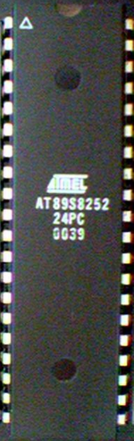
8051 Basic Component
4K bytes internal ROM
128 bytes internal RAM
Four 8-bit I/O ports (P0 - P3).
Two 16-bit timers/counters
One serial interface
CPU
RAM
ROM
A single chip
I/O Port
Serial COM Port
Microcontroller
Timer

Slide 88
Block Diagram
External Interrupts
Interrupt
Control
4k
ROM
128 bytes
RAM
Timer 1
Timer 2
CPU
OSC
Bus
Control
4 I/O Ports
Serial
P0 P2 P1 P3
TXD
RXD
Addr/Data

Slide 89
Other 8051 featurs
only 1 On chip oscillator (external crystal)
6 interrupt sources (2 external , 3 internal, Reset)
64K external code (program) memory(only read)PSEN
64K external data memory(can be read and write) by RD,WR
Code memory is selectable by EA (internal or external)
We may have External memory as data and code

Slide 90

Embedded System (8051 Application)
What is Embedded System?
An embedded system is closely integrated with the main system
It may not interact directly with the environment
For example – A microcomputer in a car ignition control
An embedded product uses a microprocessor or microcontroller to do one task only
There is only one application software that is typically burned into ROM

Slide 91
Examples of Embedded Systems
Keyboard
Printer
video game player
MP3 music players
Embedded memories to keep configuration information
Mobile phone units
Domestic (home) appliances
Data switches
Automotive controls

Slide 92
Three criteria in Choosing a Microcontroller
meeting the computing needs of the task efficiently and cost effectively
speed, the amount of ROM and RAM, the number of I/O ports and timers, size, packaging, power consumption
easy to upgrade
cost per unit
availability of software development tools
assemblers, debuggers, C compilers, emulator, simulator, technical support
wide availability and reliable sources of the microcontrollers

Slide 93
Comparison of the 8051 Family Members
ROM type
8031 no ROM
80xx mask ROM
87xx EPROM
89xx Flash EEPROM
89xx
8951
8952
8953
8955
898252
891051
892051
Example (AT89C51,AT89LV51,AT89S51)
AT= ATMEL(Manufacture)
C = CMOS technology
LV= Low Power(3.0v)

Slide 94
Comparison of the 8051 Family Members
89XX | ROM | RAM | Timer | Int Source | IO pin | Other
8951 | 4k | 128 | 2 | 6 | 32 | -
8952 | 8k | 256 | 3 | 8 | 32 | -
8953 | 12k | 256 | 3 | 9 | 32 | WD
8955 | 20k | 256 | 3 | 8 | 32 | WD
898252 | 8k | 256 | 3 | 9 | 32 | ISP
891051 | 1k | 64 | 1 | 3 | 16 | AC
892051 | 2k | 128 | 2 | 6 | 16 | AC
WD: Watch Dog Timer
AC: Analog Comparator
ISP: In System Programable

Slide 95
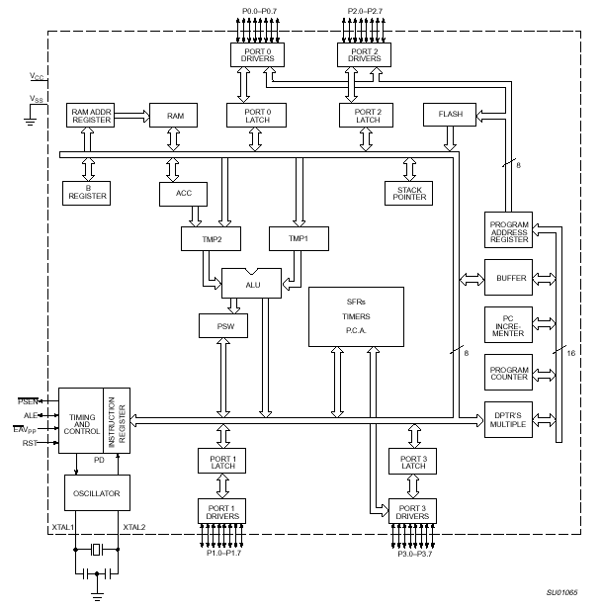
8051 Internal Block Diagram

Slide 96
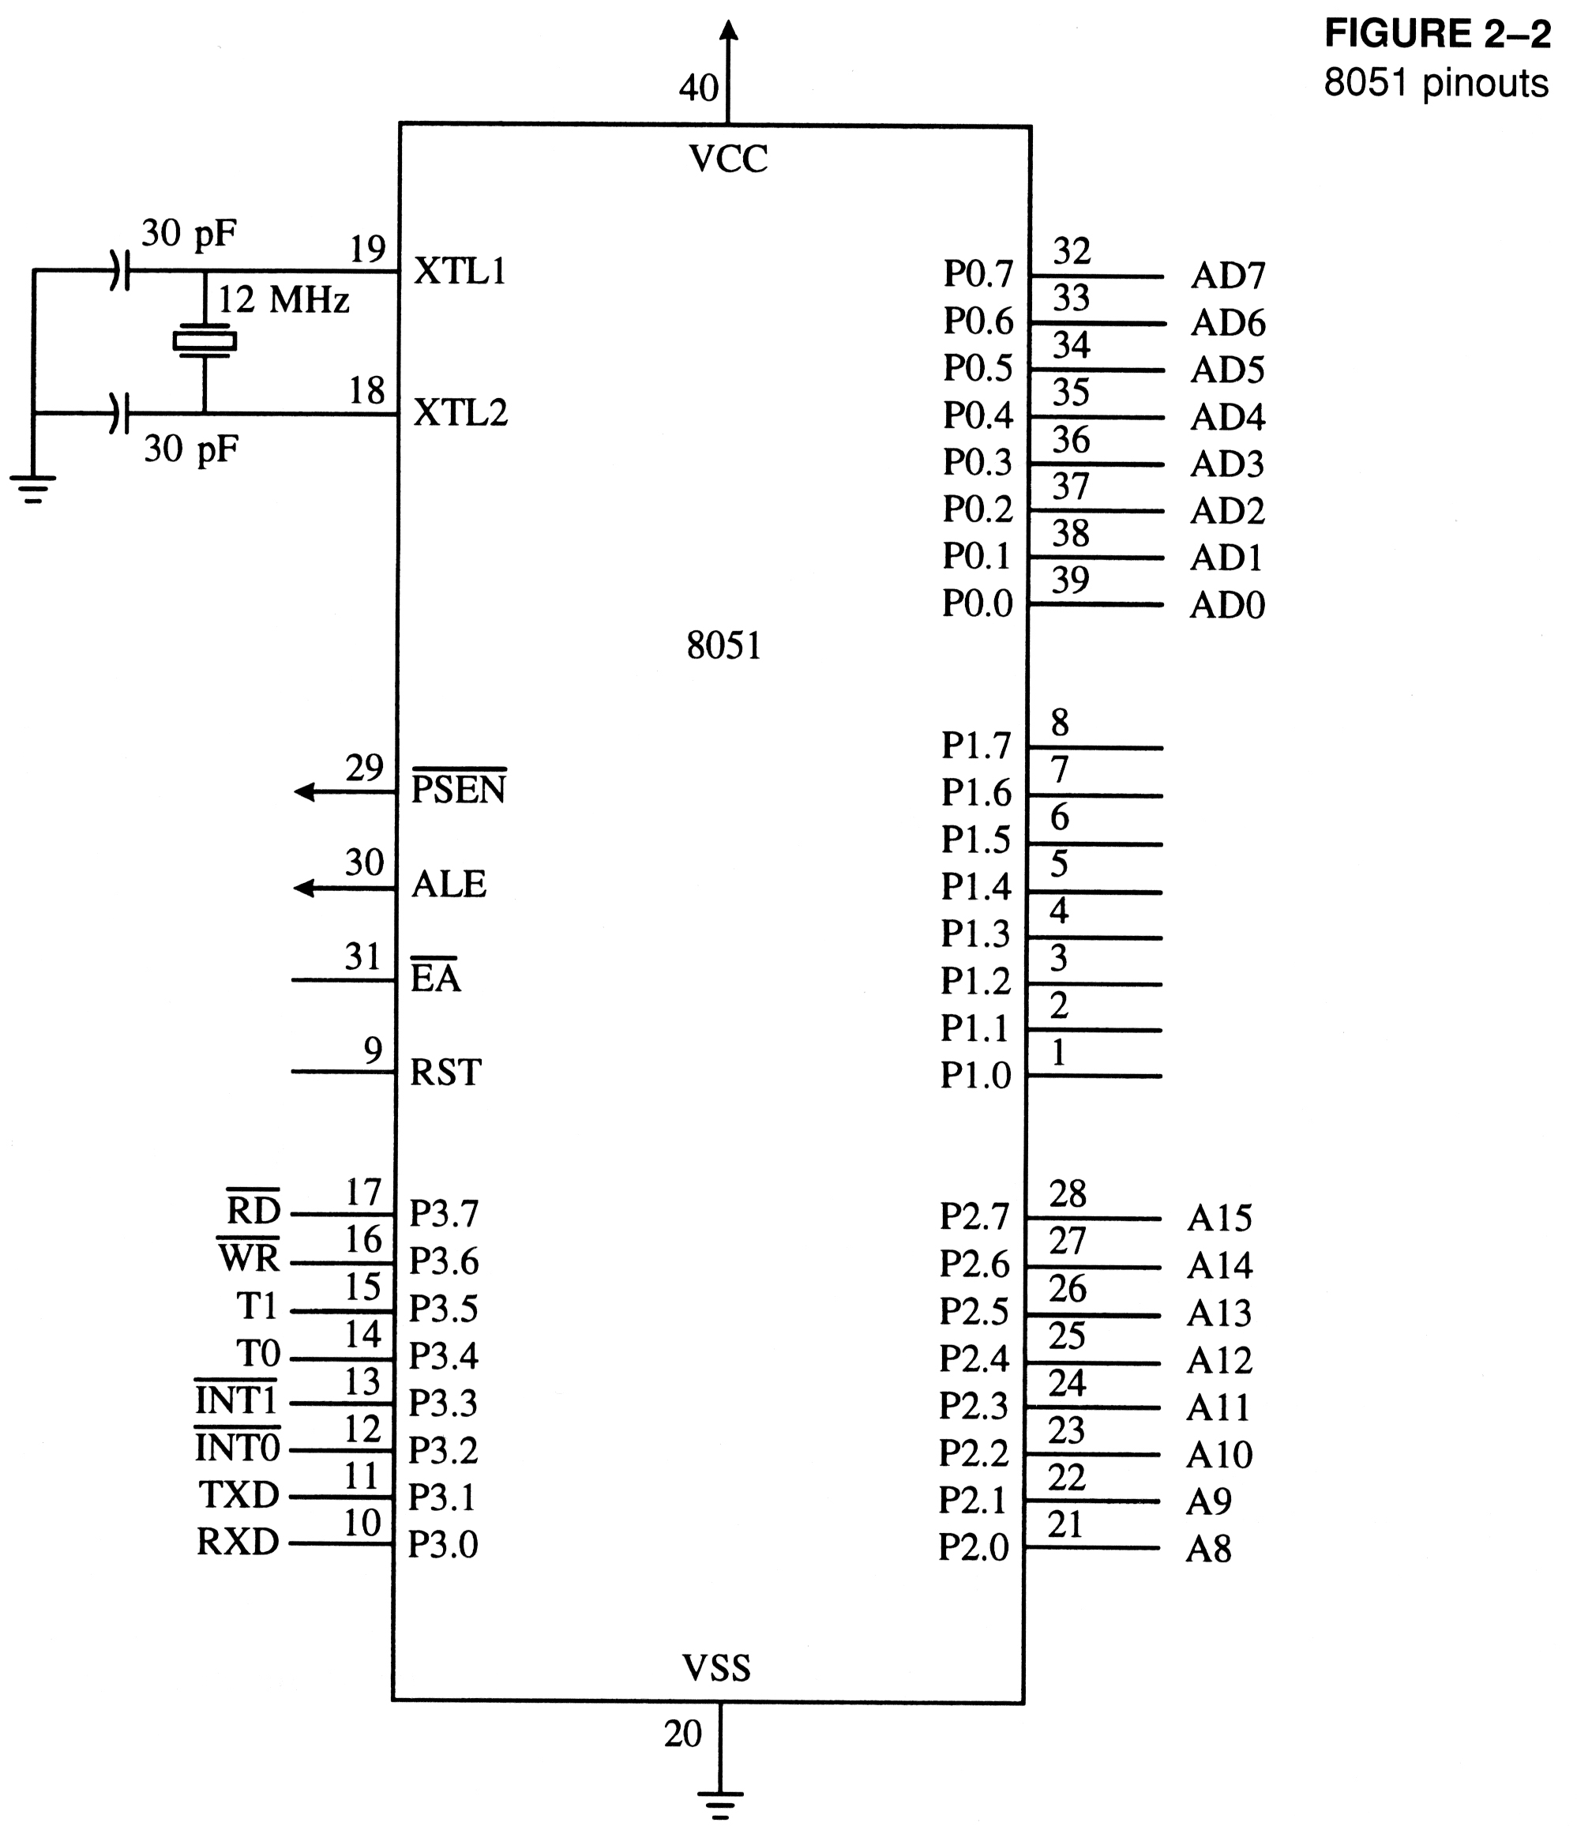
8051 Schematic Pin out

Slide 97
8051 Foot Print
P1.0
1
40
Vcc
P1.1
2
39
P0.0(AD0)
P1.2
3
38
P0.1(AD1)
P1.3
4
8051
(8031)
(8751)
(8951)
37
P0.2(AD2)
P1.4
5
36
P0.3(AD3)
P1.5
6
35
P0.4(AD4)
P1.6
7
34
P0.5(AD5)
P1.7
8
33
P0.6(AD6)
RST
9
32
P0.7(AD7)
(RXD)P3.0
10
31
EA/VPP
(TXD)P3.1
11
30
ALE/PROG
(INT0)P3.2
12
29
PSEN
(INT1)P3.3
13
28
P2.7(A15)
(T0)P3.4
14
27
P2.6(A14)
(T1)P3.5
15
26
P2.5(A13)
(WR)P3.6
16
25
P2.4(A12)
(RD)P3.7
17
24
P2.3(A11)
XTAL2
18
23
P2.2(A10)
XTAL1
19
22
P2.1(A9)
GND
20
21
P2.0(A8)

Slide 98
IMPORTANT PINS (IO Ports)
One of the most useful features of the 8051 is that it contains four I/O ports (P0 - P3)
Port 0 （pins 32-39）：P0（P0.0～P0.7）
8-bit R/W - General Purpose I/O
Or acts as a multiplexed low byte address and data bus for external memory design
Port 1 （pins 1-8） ：P1（P1.0～P1.7）
Only 8-bit R/W - General Purpose I/O
Port 2 （pins 21-28）：P2（P2.0～P2.7）
8-bit R/W - General Purpose I/O
Or high byte of the address bus for external memory design
Port 3 （pins 10-17）：P3（P3.0～P3.7）
General Purpose I/O
if not using any of the internal peripherals (timers) or external interrupts.
Each port can be used as input or output (bi-direction)

Slide 99
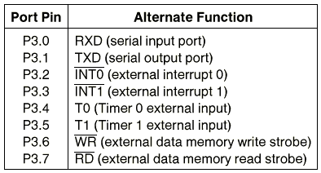
Port 3 Alternate Functions

Slide 100
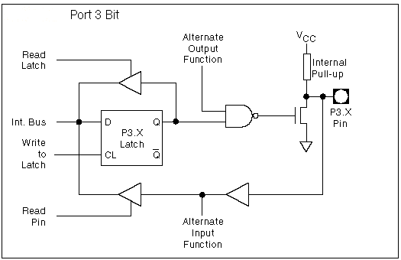
8051 Port 3 Bit Latches and I/O Buffers

Slide 101
Hardware Structure of I/O Pin
Read latch
Vcc
TB2
Load(L1)
Internal CPU bus
D Q
Clk Q
P1.X pin
P1.X
Write to latch
M1
TB1
Read pin

Slide 102
Hardware Structure of I/O Pin
Each pin of I/O ports
Internally connected to CPU bus
A D latch store the value of this pin
Write to latch＝1：write data into the D latch
2 Tri-state buffer：
TB1: controlled by “Read pin”
Read pin＝1：really read the data present at the pin
TB2: controlled by “Read latch”
Read latch＝1：read value from internal latch
A transistor M1 gate
Gate=0: open
Gate=1: close

Slide 103
Writing “1” to Output Pin P1.X
Read latch
Vcc
TB2
Load(L1)
2. output pin is Vcc
1. write a 1 to the pin
1
P1.X pin
Internal CPU bus
D Q
Clk Q
P1.X
0
output 1
Write to latch
M1
TB1
Read pin

Slide 104
Writing “0” to Output Pin P1.X
Read latch
Vcc
TB2
Load(L1)
2. output pin is ground
1. write a 0 to the pin
0
P1.X pin
Internal CPU bus
D Q
Clk Q
P1.X
1
output 0
Write to latch
M1
TB1
Read pin

Slide 105
Reading “High” at Input Pin
Read latch
Vcc
2. MOV A,P1
external pin=High
TB2
write a 1 to the pin MOV P1,#0FFH
Load(L1)
1
1
P1.X pin
Internal CPU bus
D Q
Clk Q
P1.X
0
M1
Write to latch
TB1
Read pin
3. Read pin=1 Read latch=0 Write to latch=1

Slide 106
Reading “Low” at Input Pin
Read latch
Vcc
2. MOV A,P1
external pin=Low
TB2
write a 1 to the pin
MOV P1,#0FFH
Load(L1)
1
0
P1.X pin
Internal CPU bus
D Q
Clk Q
P1.X
0
M1
Write to latch
TB1
Read pin
3. Read pin=1 Read latch=0 Write to latch=1
8051 IC

Slide 107
Port 0 with Pull-Up Resistors
Vcc
10 K
Port 0
P0.0
DS5000
8751
8951
P0.1
P0.2
P0.3
P0.4
P0.5
P0.6
P0.7

Slide 108
IMPORTANT PINS
PSEN (out): Program Store Enable, the read signal for external program memory (active low).
ALE (out): Address Latch Enable, to latch address outputs at Port0 and Port2
EA (in): External Access Enable, active low to access external program memory locations 0 to 4K
RXD,TXD: UART pins for serial I/O on Port 3
XTAL1 & XTAL2: Crystal inputs for internal oscillator.

Slide 109
Pins of 8051
Vcc（pin 40）：
Vcc provides supply voltage to the chip.
The voltage source is +5V.
GND（pin 20）：ground
XTAL1 and XTAL2（pins 19,18）：
These 2 pins provide external clock.
Way 1：using a quartz crystal oscillator
Way 2：using a TTL oscillator
Example 4-1 shows the relationship between XTAL and the machine cycle.

Slide 110
XTAL Connection to 8051
Using a quartz crystal oscillator
We can observe the frequency on the XTAL2 pin.
C2
XTAL2
30pF
C1
XTAL1
30pF
GND

Slide 111
XTAL Connection to an External Clock Source
Using a TTL oscillator
XTAL2 is unconnected.
NC
XTAL2
EXTERNAL
OSCILLATOR
SIGNAL
XTAL1
GND

Slide 112
Machine cycle
Find the machine cycle for
(a) XTAL = 11.0592 MHz
(b) XTAL = 16 MHz.
Solution:
(a) 11.0592 MHz / 12 = 921.6 kHz;
machine cycle = 1 / 921.6 kHz = 1.085 μs
(b) 16 MHz / 12 = 1.333 MHz;
machine cycle = 1 / 1.333 MHz = 0.75 μs

Slide 113
Pins of 8051
RST（pin 9）：reset
input pin and active high（normally low）.
The high pulse must be high at least 2 machine cycles.
power-on reset.
Upon applying a high pulse to RST, the microcontroller will reset and all values in registers will be lost.
Reset values of some 8051 registers
power-on reset circuit

Slide 114

Power-On RESET
Vcc
31
EA/VPP
X1
10 uF
30 pF
X2
RST
9
8.2 K

Slide 115
RESET Value of Some 8051 Registers:
Register
Reset Value
PC
0000
ACC
0000
B
0000
PSW
0000
SP
0007
DPTR
0000
RAM are all zero


Slide 116
Pins of 8051
/EA（pin 31）：external access
There is no on-chip ROM in 8031 and 8032 .
The /EA pin is connected to GND to indicate the code is stored externally.
/PSEN ＆ ALE are used for external ROM.
For 8051, /EA pin is connected to Vcc.
“/” means active low.
/PSEN（pin 29）：program store enable
This is an output pin and is connected to the OE pin of the ROM.
See Chapter 14.

Slide 117
Pins of 8051
ALE（pin 30）：address latch enable
It is an output pin and is active high.
8051 port 0 provides both address and data.
The ALE pin is used for de-multiplexing the address and data by connecting to the G pin of the 74LS373 latch.

Slide 118
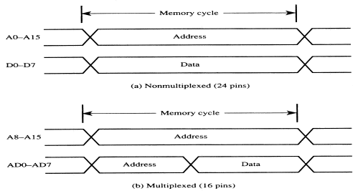
Address Multiplexing for External Memory
Figure 2-7
Multiplexing the address (low-byte) and data bus

Slide 119
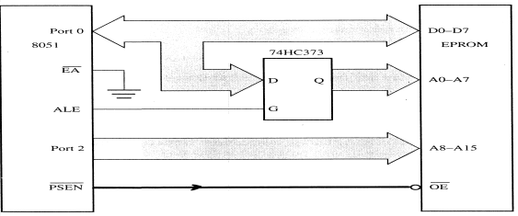
Address Multiplexing for External Memory
Figure 2-8
Accessing external code memory

Slide 120
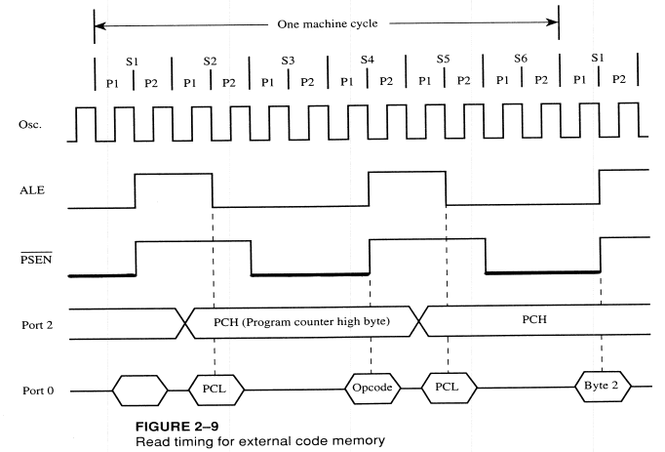

Slide 121
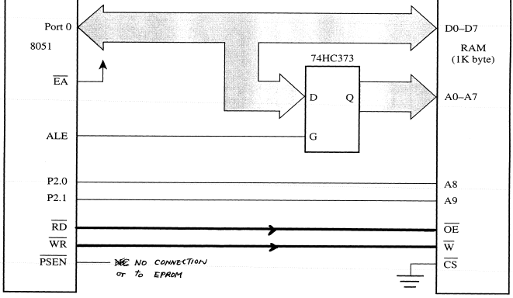
Accessing External Data Memory
Figure 2-11
Interface to 1K RAM

Slide 122
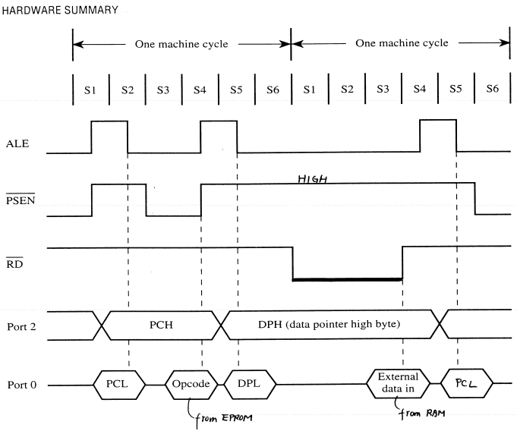
Timing for MOVX instruction

Slide 123
External code memory
WR
RD
PSEN
OE
ALE
74LS373
CS
G
P0.0
P0.7
A0
A7
D
D0
D7
EA
P2.0
P2.7
A8
A15
8051
ROM

Slide 124
External data memory
WR
WR
RD
RD
PSEN
ALE
74LS373
CS
G
P0.0
P0.7
A0
A7
D
D0
D7
EA
P2.0
P2.7
A8
A15
8051
RAM

Slide 125
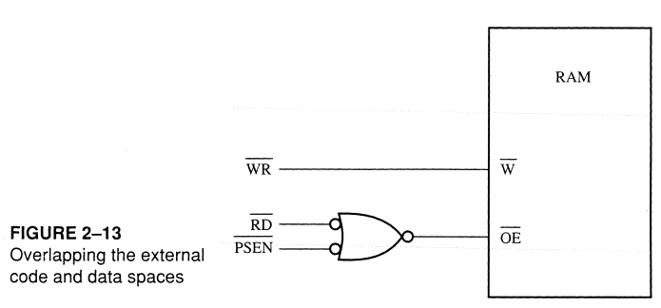
Overlapping External Code and Data Spaces

Slide 126
Overlapping External Code and Data Spaces
WR
WR
RD
PSEN
RD
ALE
74LS373
CS
G
P0.0
P0.7
A0
A7
D
D0
D7
EA
P2.0
P2.7
A8
A15
8051
RAM

Slide 127
Overlapping External Code and Data Spaces
Allows the RAM to be
written as data memory, and
read as data memory as well as code memory.
This allows a program to be
downloaded from outside into the RAM as data, and
executed from RAM as code.

Slide 128
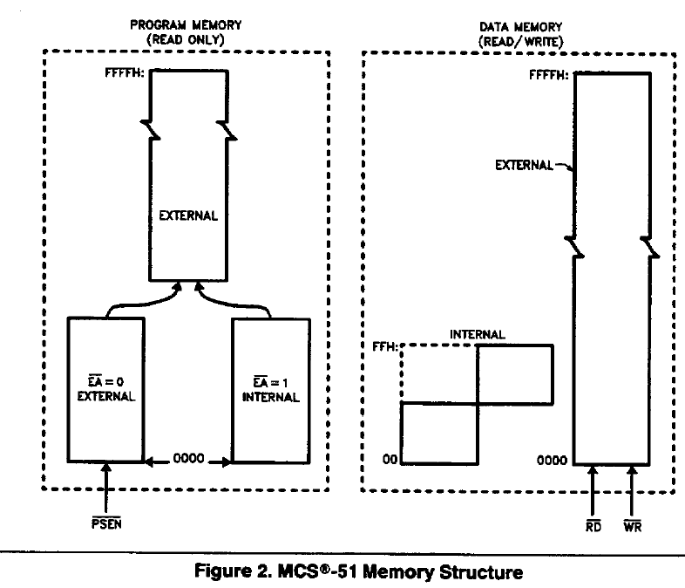

Slide 129
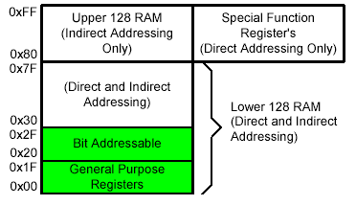
On-Chip Memory Internal RAM

Slide 130
Registers
1F
18
Bank 3
Four Register Banks
Each bank has R0-R7
Selectable by psw.2,3
17
10
Bank 2
0F
08
Bank 1
07
06
05
04
03
02
01
00
R7
R6
R5
R4
R3
R2
R1
R0
Bank 0

Slide 131
Bit Addressable Memory
2F
2E
2D
2C
2B
2A
29
28
7F |  |  |  |  |  |  | 78
 |  |  |  |  | 1A
 |  |  |  |  |  |  | 10
0F |  |  |  |  |  |  | 08
07 | 06 | 05 | 04 | 03 | 02 | 01 | 00
20h – 2Fh (16 locations X 8-bits = 128 bits)
Bit addressing:
mov C, 1Ah
or
mov C, 23h.2
27
26
25
24
23
22
21
20

Slide 132
Special Function Registers
DATA registers
CONTROL registers
Timers
Serial ports
Interrupt system
Analog to Digital converter
Digital to Analog converter
Etc.
Addresses 80h – FFh
Direct Addressing used to access SPRs

Slide 133
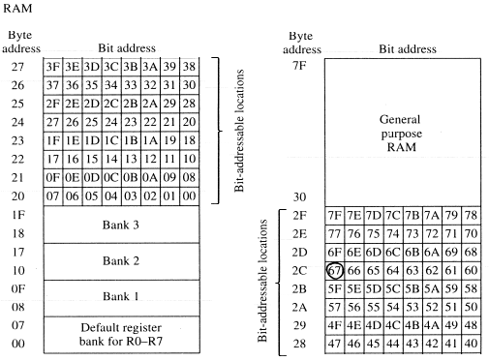
Bit Addressable RAM
Figure 2-6
Summary of the 8051 on-chip data memory
(RAM)

Slide 134
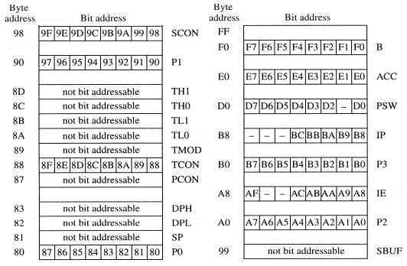
Bit Addressable RAM
Figure 2-6
Summary of the 8051 on-chip data memory
(Special Function Registers)

Slide 135
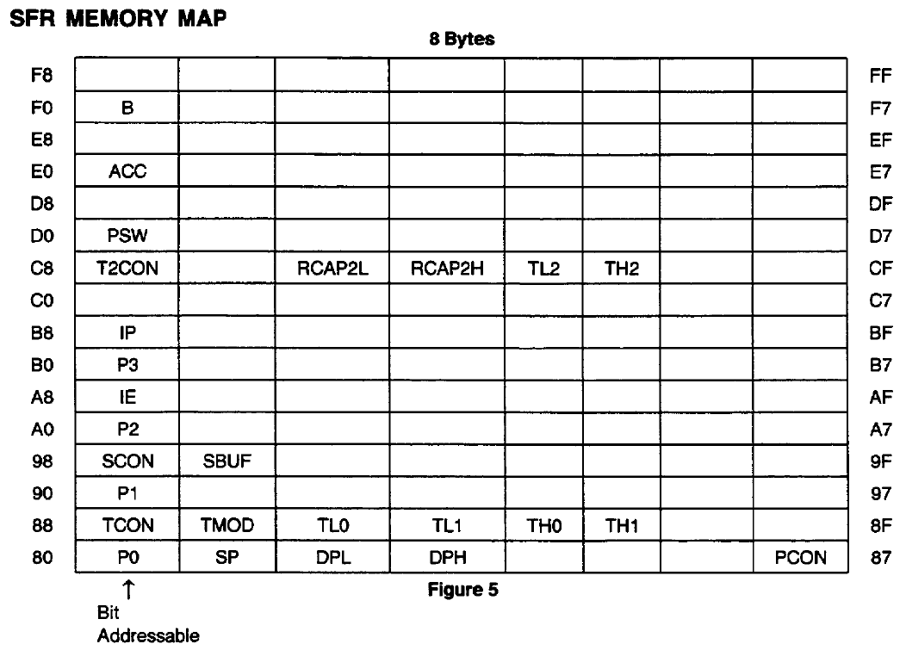

Slide 136
Register Banks
Active bank selected by PSW [RS1,RS0] bit
Permits fast “context switching” in interrupt service routines (ISR).

Slide 137
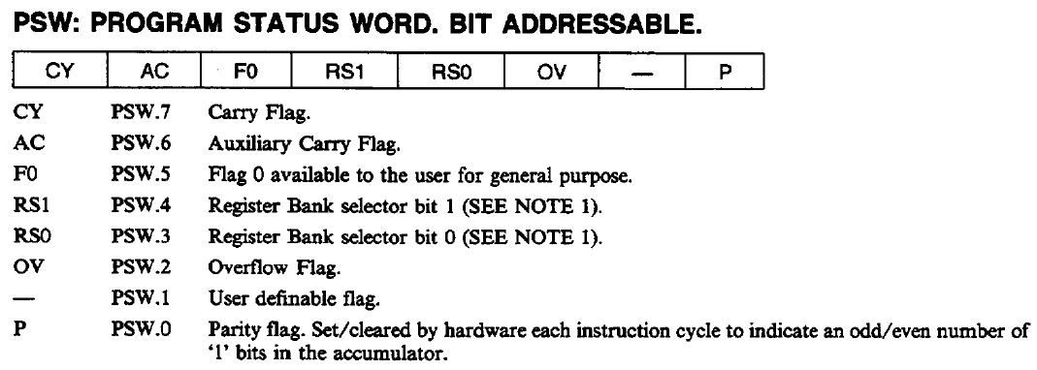
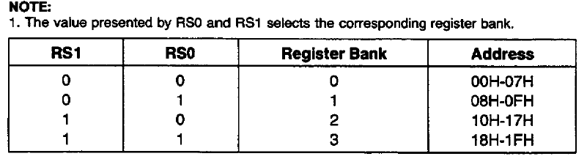

Slide 138
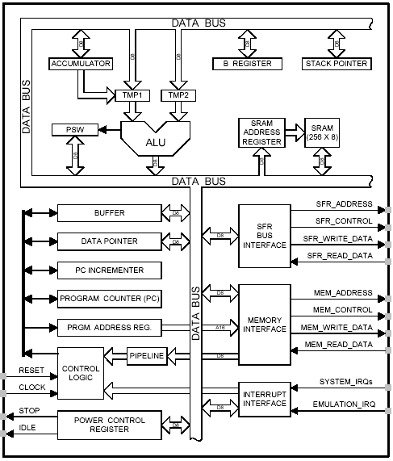
8051 CPU Registers
A (Accumulator)
B
PSW (Program Status Word)
SP (Stack Pointer)
PC (Program Counter)
DPTR (Data Pointer)
Used in assembler instructions

Slide 139
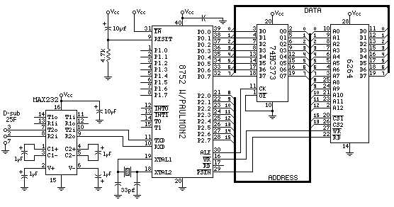
Registers

Slide 140
Registers
A
B
R0
DPTR
DPH
DPL
R1
R2
PC
PC
R3
R4
Some 8051 16-bit Register
R5
R6
R7
Some 8-bit Registers of the 8051

Slide 141
The 8051 Assembly Language

Slide 142
Overview
Data transfer instructions
Addressing modes
Data processing (arithmetic and logic)
Program flow instructions

Slide 143
Data Transfer Instructions
MOV dest, source dest ← source
Stack instructions
PUSH byte ;increment stack pointer, ;move byte on stack
POP byte ;move from stack to byte, ;decrement stack pointer
Exchange instructions
XCH a, byte ;exchange accumulator and byte
XCHD a, byte ;exchange low nibbles of ;accumulator and byte

Slide 144
Addressing Modes
Immediate Mode – specify data by its value
mov A, #0 ;put 0 in the accumulator
;A = 00000000
mov R4, #11h ;put 11hex in the R4 register
;R4 = 00010001
mov B, #11 ;put 11 decimal in b register
;B = 00001011
mov DPTR,#7521h ;put 7521 hex in DPTR
;DPTR = 0111010100100001

Slide 145
Addressing Modes
Immediate Mode – continue
MOV DPTR,#7521h
MOV DPL,#21H
MOV DPH, #75
COUNT EGU 30
~
~
mov R4, #COUNT
MOV DPTR,#MYDATA
~
~
0RG 200H
MYDATA:DB “IRAN”

Slide 146
Addressing Modes
Register Addressing – either source or destination is one of CPU register
MOV R0,A
MOV A,R7
ADD A,R4
ADD A,R7
MOV DPTR,#25F5H
MOV R5,DPL
MOV R,DPH
Note that MOV R4,R7 is incorrect

Slide 147
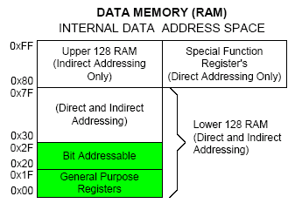
Addressing Modes
Direct Mode – specify data by its 8-bit address
Usually for 30h-7Fh of RAM
Mov a, 70h ; copy contents of RAM at 70h to a
Mov R0,40h ; copy contents of RAM at 70h to a
Mov 56h,a ; put contents of a at 56h to a
Mov 0D0h,a ; put contents of a into PSW

Slide 148
Addressing Modes
Direct Mode – play with R0-R7 by direct address
MOV A,4 ≡ MOV A,R4
MOV A,7 ≡ MOV A,R7
MOV 7,2 ≡ MOV R7,R6
MOV R2,#5 ;Put 5 in R2
MOV R2,5 ;Put content of RAM at 5 in R2

Slide 149
Addressing Modes
Register Indirect – the address of the source or destination is specified in registers
Uses registers R0 or R1 for 8-bit address:
mov psw, #0 ; use register bank 0
mov r0, #0x3C
mov @r0, #3 ; memory at 3C gets #3
; M[3C] ← 3
Uses DPTR register for 16-bit addresses:
mov dptr, #0x9000 ; dptr ← 9000h
movx a, @dptr ; a ← M[9000]
Note that 9000 is an address in external memory

Slide 150
Use Register Indirect to access upper RAM block (+8052)

Slide 151
Addressing Modes
Register Indexed Mode – source or destination address is the sum of the base address and the accumulator(Index)
Base address can be DPTR or PC
mov dptr, #4000h
mov a, #5
movc a, @a + dptr ;a ← M[4005]

Slide 152
Addressing Modes
Register Indexed Mode continue
Base address can be DPTR or PC
ORG 1000h
1000 mov a, #5
movc a, @a + PC ;a ← M[1008]
Nop
Table Lookup
MOVC only can read internal code memory
PC

Slide 153
Acc Register
A register can be accessed by direct and register mode
This 3 instruction has same function with different code
0703 E500 mov a,00h
0705 8500E0 mov acc,00h
0708 8500E0 mov 0e0h,00h
Also this 3 instruction
070B E9 mov a,r1
070C 89E0 mov acc,r1
070E 89E0 mov 0e0h,r1

Slide 154
SFRs Address
B – always direct mode - except in MUL & DIV
0703 8500F0 mov b,00h
0706 8500F0 mov 0f0h,00h
0709 8CF0 mov b,r4
070B 8CF0 mov 0f0h,r4
P0~P3 – are direct address
0704 F580 mov p0,a
0706 F580 mov 80h,a
0708 859080 mov p0,p1
Also other SFRs (pcon, tmod, psw,….)

Slide 155
SFRs Address
All SFRs such as
(ACC, B, PCON, TMOD, PSW, P0~P3, …)
are accessible by name and direct address
But
both of them
Must be coded as direct address

Slide 156
8051 Instruction Format
immediate addressing
add a,#3dh ;machine code=243d
Direct addressing
mov r3,0E8h ;machine code=ABE8
Op code
Immediate data
Op code
Direct address

Slide 157
8051 Instruction Format
Register addressing
070D E8 mov a,r0 ;E8 = 1110 1000
070E E9 mov a,r1 ;E9 = 1110 1001
070F EA mov a,r2 ;EA = 1110 1010
0710 ED mov a,r5 ;ED = 1110 1101
0711 EF mov a,r7 ;Ef = 1110 1111
0712 2F add a,r7
0713 F8 mov r0,a
0714 F9 mov r1,a
0715 FA mov r2,a
0716 FD mov r5,a
0717 FD mov r5,a
Op code | n | n | n

Slide 158
8051 Instruction Format
Register indirect addressing
mov a, @Ri ; i = 0 or 1
070D E7 mov a,@r1
070D 93 movc a,@a+dptr
070E 83 movc a,@a+pc
070F E0 movx a,@dptr
0710 F0 movx @dptr,a
0711 F2 movx @r0,a
0712 E3 movx a,@r1
Op code | i

Slide 159
8051 Instruction Format
relative addressing
here: sjmp here ;machine code=80FE(FE=-2)
Range = (-128 ~ 127)
Absolute addressing (limited in 2k current mem block)
0700 1 org 0700h
0700 E106 2 ajmp next ;next=706h
0702 00 3 nop
0703 00 4 nop
0704 00 5 nop
0705 00 6 nop
7 next:
8 end
Op code
Relative address
A10-A8 | Op code
A7-A0
07FEh

Slide 160
8051 Instruction Format
Long distance address
Range = (0000h ~ FFFFh)
0700 1 org 0700h
0700 020707 2 ajmp next ;next=0707h
0703 00 3 nop
0704 00 4 nop
0705 00 5 nop
0706 00 6 nop
7 next:
8 end
Op code
A15-A8
A7-A0

Slide 161
Stacks
pop
push
stack pointer
stack
Go do the stack exercise…..

Slide 162
Stack
Stack-oriented data transfer
Only one operand (direct addressing)
SP is other operand – register indirect - implied
Direct addressing mode must be used in Push and Pop
mov sp, #0x40 ; Initialize SP
push 0x55 ; SP ← SP+1, M[SP] ← M[55]
; M[41] ← M[55]
pop b ; b ← M[55]
Note: can only specify RAM or SFRs (direct mode) to push or pop. Therefore, to push/pop the accumulator, must use acc, not a

Slide 163
Stack (push,pop)
Therefore
Push a ;is invalid
Push r0 ;is invalid
Push r1 ;is invalid
push acc ;is correct
Push psw ;is correct
Push b ;is correct
Push 13h
Push 0
Push 1
Pop 7
Pop 8
Push 0e0h ;acc
Pop 0f0h ;b

Slide 164
Exchange Instructions
two way data transfer
XCH a, 30h ; a ←→ M[30]
XCH a, R0 ; a ←→ R0
XCH a, @R0 ; a ←→ M[R0]
XCHD a, R0 ; exchange “digit”
a[7..4] a[3..0]
R0[7..4] R0[3..0]
Only 4 bits exchanged

Slide 165
Bit-Oriented Data Transfer
transfers between individual bits.
Carry flag (C) (bit 7 in the PSW) is used as a single-bit accumulator
RAM bits in addresses 20-2F are bit addressable
mov C, P0.0
mov C, 67h
mov C, 2ch.7

Slide 166
SFRs that are Bit Addressable
SFRs with addresses ending in 0 or 8 are bit-addressable.
(80, 88, 90, 98, etc)
Notice that all 4 parallel I/O ports are bit addressable.

Slide 167
Data Processing Instructions
Arithmetic Instructions
Logic Instructions

Slide 168
Arithmetic Instructions
Add
Subtract
Increment
Decrement
Multiply
Divide
Decimal adjust

Slide 169
Arithmetic Instructions
Mnemonic | Description
ADD A, byte | add A to byte, put result in A
ADDC A, byte | add with carry
SUBB A, byte | subtract with borrow
INC A | increment A
INC byte | increment byte in memory
INC DPTR | increment data pointer
DEC A | decrement accumulator
DEC byte | decrement byte
MUL AB | multiply accumulator by b register
DIV AB | divide accumulator by b register
DA A | decimal adjust the accumulator

Slide 170
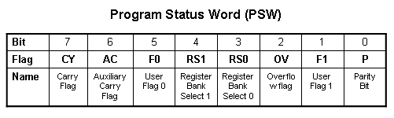
ADD Instructions
add a, byte ; a ← a + byte
addc a, byte ; a ← a + byte + C
These instructions affect 3 bits in PSW:
C = 1 if result of add is greater than FF
AC = 1 if there is a carry out of bit 3
OV = 1 if there is a carry out of bit 7, but not from bit 6, or visa versa.

Slide 171
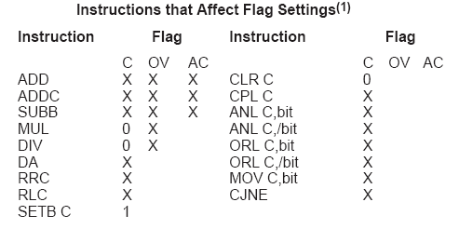
Instructions that Affect PSW bits

Slide 172
ADD Examples
mov a, #3Fh
add a, #D3h
What is the value of the C, AC, OV flags after the second instruction is executed?
0011 1111
1101 0011
0001 0010
C = 1
AC = 1
OV = 0

Slide 173
Signed Addition and Overflow
0111 1111 (positive 127)
0111 0011 (positive 115)
1111 0010 (overflow cannot represent 242 in 8 bits 2’s complement)
2’s complement:
0000 0000 00 0
…
0111 1111 7F 127
1000 0000 80 -128
…
1111 1111 FF -1
1000 1111 (negative 113)
1101 0011 (negative 45)
0110 0010 (overflow)
0011 1111 (positive)
1101 0011 (negative)
0001 0010 (never overflows)

Slide 174
Addition Example
; Computes Z = X + Y
; Adds values at locations 78h and 79h and puts them in 7Ah
;------------------------------------------------------------------
X equ 78h
Y equ 79h
Z equ 7Ah
;-----------------------------------------------------------------
org 00h
ljmp Main
;-----------------------------------------------------------------
org 100h
Main:
mov a, X
add a, Y
mov Z, a
end

Slide 175
The 16-bit ADD example
; Computes Z = X + Y (X,Y,Z are 16 bit)
;------------------------------------------------------------------
X equ 78h
Y equ 7Ah
Z equ 7Ch
;-----------------------------------------------------------------
org 00h
ljmp Main
;-----------------------------------------------------------------
org 100h
Main:
mov a, X
add a, Y
mov Z, a
mov a, X+1
adc a, Y+1
mov Z+1, a
end

Slide 176
Subtract
SUBB A, byte | subtract with borrow
Example:
SUBB A, #0x4F ;A ← A – 4F – C
Notice that
There is no subtraction WITHOUT borrow.
Therefore, if a subtraction without borrow is desired,
it is necessary to clear the C flag.
Example:
Clr c
SUBB A, #0x4F ;A ← A – 4F

Slide 177
Increment and Decrement
INC A | increment A
INC byte | increment byte in memory
INC DPTR | increment data pointer
DEC A | decrement accumulator
DEC byte | decrement byte
The increment and decrement instructions do NOT affect the C flag.
Notice we can only INCREMENT the data pointer, not decrement.

Slide 178
Example: Increment 16-bit Word
Assume 16-bit word in R3:R2
mov a, r2
add a, #1 ; use add rather than increment to affect C
mov r2, a
mov a, r3
addc a, #0 ; add C to most significant byte
mov r3, a

Slide 179
Multiply
When multiplying two 8-bit numbers, the size of the maximum product is 16-bits
FF x FF = FE01
(255 x 255 = 65025)
MUL AB ; BA ← A * B
Note : B gets the High byte
A gets the Low byte

Slide 180
Division
Integer Division
DIV AB ; divide A by B
A ← Quotient(A/B)
B ← Remainder(A/B)
OV - used to indicate a divide by zero condition.
C – set to zero

Slide 181
Decimal Adjust
DA a ; decimal adjust a
Used to facilitate BCD addition.
Adds “6” to either high or low nibble after an addition
to create a valid BCD number.
Example:
mov a, #23h
mov b, #29h
add a, b ; a ← 23h + 29h = 4Ch (wanted 52)
DA a ; a ← a + 6 = 52

Slide 182
Logic Instructions
Bitwise logic operations
(AND, OR, XOR, NOT)
Clear
Rotate
Swap
Logic instructions do NOT affect the flags in PSW

Slide 183
Bitwise Logic
Examples:
ANL ➔ AND
ORL ➔ OR
XRL ➔ XOR
CPL ➔ Complement
00001111
10101100
ANL
00001100
00001111
10101100
ORL
10101111
00001111
10101100
XRL
10100011
CPL
10101100
01010011

Slide 184
Address Modes with Logic
ANL – AND
ORL – OR
XRL – eXclusive oR
CPL – Complement
a, byte
direct, reg. indirect, reg, immediate
byte, a
direct
byte, #constant
a ex: cpl a

Slide 185
Uses of Logic Instructions
Force individual bits low, without affecting other bits.
anl PSW, #0xE7 ;PSW AND 11100111
Force individual bits high.
orl PSW, #0x18 ;PSW OR 00011000
Complement individual bits
xrl P1, #0x40 ;P1 XRL 01000000

Slide 186
Other Logic Instructions
CLR - clear
RL – rotate left
RLC – rotate left through Carry
RR – rotate right
RRC – rotate right through Carry
SWAP – swap accumulator nibbles

Slide 187
CLR ( Set all bits to 0)
CLR A
CLR byte (direct mode)
CLR Ri (register mode)
CLR @Ri (register indirect mode)

Slide 188
Rotate
Rotate instructions operate only on a
RL a
Mov a,#0xF0 ; a← 11110000
RR a ; a← 11100001
RR a
Mov a,#0xF0 ; a← 11110000
RR a ; a← 01111000

Slide 189
Rotate through Carry
C
RRC a
mov a, #0A9h ; a ← A9
add a, #14h ; a ← BD (10111101), C←0
rrc a ; a ← 01011110, C←1
RLC a
mov a, #3ch ; a ← 3ch(00111100)
setb c ; c ← 1
rlc a ; a ← 01111001, C←1
C

Slide 190
Rotate and Multiplication/Division
Note that a shift left is the same as multiplying by 2, shift right is divide by 2
mov a, #3 ; A← 00000011 (3)
clr C ; C← 0
rlc a ; A← 00000110 (6)
rlc a ; A← 00001100 (12)
rrc a ; A← 00000110 (6)

Slide 191
Swap
SWAP a
mov a, #72h ; a ← 27h
swap a ; a ← 27h

Slide 192
Bit Logic Operations
Some logic operations can be used with single bit operands
ANL C, bit
ORL C, bit
CLR C
CLR bit
CPL C
CPL bit
SETB C
SETB bit
“bit” can be any of the bit-addressable RAM locations or SFRs.

Slide 193
Shift/Mutliply Example
Program segment to multiply by 2 and add 1.

Slide 194
Program Flow Control
Unconditional jumps (“go to”)
Conditional jumps
Call and return

Slide 195
Unconditional Jumps
SJMP <rel addr> ; Short jump, relative address is 8-bit 2’s complement number, so jump can be up to 127 locations forward, or 128 locations back.
LJMP <address 16> ; Long jump
AJMP <address 11> ; Absolute jump to anywhere within 2K block of program memory
JMP @A + DPTR ; Long indexed jump

Slide 196
Infinite Loops
Start: mov C, p3.7
mov p1.6, C
sjmp Start
Microcontroller application programs are almost always infinite loops!

Slide 197
Re-locatable Code
Memory specific NOT Re-locatable (machine code)
org 8000h
Start: mov C, p1.6
mov p3.7, C
ljmp Start
end
Re-locatable (machine code)
org 8000h
Start: mov C, p1.6
mov p3.7, C
sjmp Start
end

Slide 198
Jump table
Mov dptr,#jump_table
Mov a,#index_number
Rl a
Jmp @a+dptr
...
Jump_table: ajmp case0
ajmp case1
ajmp case2
ajmp case3

Slide 199
Conditional Jump
These instructions cause a jump to occur only if a condition is true. Otherwise, program execution continues with the next instruction.
loop: mov a, P1
jz loop ; if a=0, goto loop, ; else goto next instruction
mov b, a
There is no zero flag (z)
Content of A checked for zero on time

Slide 200
Conditional jumps
Mnemonic | Description
JZ <rel addr> | Jump if a = 0
JNZ <rel addr> | Jump if a != 0
JC <rel addr> | Jump if C = 1
JNC <rel addr> | Jump if C != 1
JB <bit>, <rel addr> | Jump if bit = 1
JNB <bit>,<rel addr> | Jump if bit != 1
JBC <bir>, <rel addr> | Jump if bit =1, &clear bit
CJNE A, direct, <rel addr> | Compare A and memory, jump if not equal

Slide 201
Example: Conditional Jumps
if (a = 0) is true
send a 0 to LED
else
send a 1 to LED
jz led_off
Setb P1.6
sjmp skipover
led_off: clr P1.6
mov A, P0
skipover:

Slide 202
More Conditional Jumps
Mnemonic | Description
CJNE A, #data <rel addr> | Compare A and data, jump if not equal
CJNE Rn, #data <rel addr> | Compare Rn and data, jump if not equal
CJNE @Rn, #data <rel addr> | Compare Rn and memory, jump if not equal
DJNZ Rn, <rel addr> | Decrement Rn and then jump if not zero
DJNZ direct, <rel addr> | Decrement memory and then jump if not zero

Slide 203
Iterative Loops
For A = 0 to 4 do
{…}
clr a
loop: ...
...
inc a
cjne a, #4, loop
For A = 4 to 0 do
{…}
mov R0, #4
loop: ...
...
djnz R0, loop

Slide 204
Iterative Loops(examples)
mov a,#50h
mov b,#00h
cjne a,#50h,next
mov b,#01h
next: nop
end
mov a,#25h
mov r0,#10h
mov r2,#5
Again: mov @ro,a
inc r0
djnz r2,again
end
mov a,#0aah
mov b,#10h
Back1:mov r6,#50
Back2:cpl a
djnz r6,back2
djnz b,back1
end
mov a,#0h
mov r4,#12h
Back: add a,#05
djnz r4,back
mov r5,a
end

Slide 205
Call and Return
Call is similar to a jump, but
Call pushes PC on stack before branching
acall <address ll> ; stack ← PC
; PC ← address 11 bit
lcall <address 16> ; stack ← PC
; PC ← address 16 bit

Slide 206
Return
Return is also similar to a jump, but
Return instruction pops PC from stack to get address to jump to
ret ; PC ← stack

Slide 207
Subroutines
call to the subroutine
Main: ...
acall sublabel
...
...
sublabel: ...
...
ret
the subroutine

Slide 208
Initializing Stack Pointer
SP is initialized to 07 after reset.(Same address as R7)
With each push operation 1st , pc is increased
When using subroutines, the stack will be used to store the PC, so it is very important to initialize the stack pointer. Location 2Fh is often used.
mov SP, #2Fh

Slide 209
Subroutine - Example
square: push b
mov b,a
mul ab
pop b
ret
8 byte and 11 machine cycle
square: inc a
movc a,@a+pc
ret
table: db 0,1,4,9,16,25,36,49,64,81
13 byte and 5 machine cycle

Slide 210
Subroutine – another example
; Program to compute square root of value on Port 3
; (bits 3-0) and output on Port 1.
org 0
ljmp Main
Main: mov P3, #0xFF ; Port 3 is an input
loop: mov a, P3
anl a, #0x0F ; Clear bits 7..4 of A
lcall sqrt
mov P1, a
sjmp loop
sqrt: inc a
movc a, @a + PC
ret
Sqrs: db 0,1,1,1,2,2,2,2,2,3,3,3,3,3,3,3
end
reset service
main program
subroutine
data

Slide 211
Why Subroutines?
Subroutines allow us to have "structured" assembly language programs.
This is useful for breaking a large design into manageable parts.
It saves code space when subroutines can be called many times in the same program.

Slide 212
example of delay
mov a,#0aah
Back1:mov p0,a
lcall delay1
cpl a
sjmp back1
Delay1:mov r0,#0ffh;1cycle
Here: djnz r0,here ;2cycle
ret ;2cycle
end
Delay=1+255*2+2=513 cycle
Delay2:
mov r6,#0ffh
back1: mov r7,#0ffh ;1cycle
Here: djnz r7,here ;2cycle
djnz r6,back1;2cycle ret ;2cycle
end
Delay=1+(1+255*2+2)*255+2
=130818 machine cycle

Slide 213
Long delay Example
GREEN_LED: equ P1.6
org ooh
ljmp Main
org 100h
Main: clr GREEN_LED
Again: acall Delay
cpl GREEN_LED
sjmp Again
Delay: mov R7, #02
Loop1: mov R6, #00h
Loop0: mov R5, #00h
djnz R5, $
djnz R6, Loop0
djnz R7, Loop1
ret
END
reset service
main program
subroutine

Slide 214
Example
; Move string from code memory to RAM
org 0
mov dptr,#string
mov r0,#10h
Loop1: clr a
movc a,@a+dptr
jz stop
mov @r0,a
inc dptr
inc r0
sjmp loop1
Stop: sjmp stop
; on-chip code memory used for string
org 18h
String: db ‘this is a string’,0
end

Slide 215
Example
; p0:input p1:output
mov a,#0ffh
mov p0,a
back: mov a,p0
mov p1,a
sjmp back
setb p1.2
mov a,#45h ;data
Again: jnb p1.2,again ;wait for data request
mov p0,a ;enable strobe
setb p2.3
clr p2.3

Slide 216
Example
; duty cycle 50%
back: cpl p1.2
acall delay
sjmp back
back: setb p1.2
acall delay
Clr p1.2
acall delay
sjmp back

Slide 217
Example
; duty cycle 66%
back: setb p1.2
acall delay
acall delay
Clr p1.2
acall delay
sjmp back

Slide 218
8051 timer

Slide 219
Interrupts
…
mov a, #2
mov b, #16
mul ab
mov R0, a
mov R1, b
mov a, #12
mov b, #20
mul ab
add a, R0
mov R0, a
mov a, R1
addc a, b
mov R1, a
end
interrupt
ISR: inc r7
mov a,r7
jnz NEXT
cpl P1.6
NEXT: reti
Program Execution
return

Slide 220
Interrupt Sources
Original 8051 has 5 sources of interrupts
Timer 0 overflow
Timer 1 overflow
External Interrupt 0
External Interrupt 1
Serial Port events (buffer full, buffer empty, etc)
Enhanced version has 22 sources
More timers, programmable counter array, ADC, more external interrupts, another serial port (UART)

Slide 221
Interrupt Process
If interrupt event occurs AND interrupt flag for that event is enabled, AND interrupts are enabled, then:
Current PC is pushed on stack.
Program execution continues at the interrupt vector address for that interrupt.
When a RETI instruction is encountered, the PC is popped from the stack and program execution resumes where it left off.

Slide 222
Interrupt Priorities
What if two interrupt sources interrupt at the same time?
The interrupt with the highest PRIORITY gets serviced first.
All interrupts have a default priority order.
Priority can also be set to “high” or “low”.

Slide 223
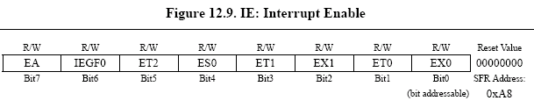
Interrupt SFRs
Interrupt enables for the 5 original 8051 interrupts:
Timer 2
Serial (UART0)
Timer 1
External 1
Timer 0
External 0
Global Interrupt Enable – must be set to 1 for any interrupt to be enabled
1 = Enable
0 = Disable

Slide 224
Interrupt Vectors
Each interrupt has a specific place in code memory where program execution (interrupt service routine) begins.
External Interrupt 0: 0003h
Timer 0 overflow: 000Bh
External Interrupt 1: 0013h
Timer 1 overflow: 001Bh
Serial : 0023h
Timer 2 overflow(8052+) 002bh
Note: that there are only 8 memory locations between vectors.

Slide 225
Interrupt Vectors
To avoid overlapping Interrupt Service routines, it is common to put JUMP instructions at the vector address. This is similar to the reset vector.
org 009B ; at EX7 vector
ljmp EX7ISR
cseg at 0x100 ; at Main program
Main: ... ; Main program
...
EX7ISR:... ; Interrupt service routine
... ; Can go after main program
reti ; and subroutines.

Slide 226
Example Interrupt Service Routine
;EX7 ISR to blink the LED 5 times.
;Modifies R0, R5-R7, bank 3.
;----------------------------------------------------
ISRBLK: push PSW ;save state of status word
mov PSW,#18h ;select register bank 3
mov R0, #10 ;initialize counter
Loop2: mov R7, #02h ;delay a while
Loop1: mov R6, #00h
Loop0: mov R5, #00h
djnz R5, $
djnz R6, Loop0
djnz R7, Loop1
cpl P1.6 ;complement LED value
djnz R0, Loop2 ;go on then off 10 times
pop PSW
reti

